Slide 1


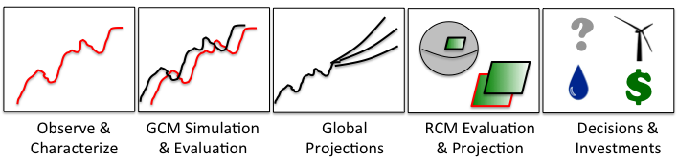
Scientific Applications of the Regional Climate Model Evaluation System (RCMES)
Jet Propulsion Laboratory
California Institute of Technology
Paul C. Loikith, Duane E. Waliser, Chris Mattmann, Jinwon Kim, Huikyo Lee, Paul M. Ramirez, Andrew F. Hart, Cameron E. Goodale, Michael J. Joyce, Shakeh E. Khudikyan, Maziyar Boustani, Kim Whitehall, Alex Goodman, Jesslyn Whittell, and Paul Zimdars
WCRP VAMOS/CORDEX Workshop of Latin-America and Caribbean CORDEX
Phase 1-South America
September, 11-13, 2013
Lima, Perú
rcmes.jpl.nasa.gov

Slide 2
The Regional Climate Model Evaluation System (RCMES)
Jet Propulsion Laboratory
California Institute of Technology
Joint collaboration: JPL/NASA, UCLA
Designed to facility model evaluation and decision making
  Provides access to numerous (NASA) observation datasets (RCMED)
  Python-based built-in toolkit (RCMET) has regridding capabilities and calculates and visualizes several common metrics (RMSE, Bias)
Initial target: CORDEX
rcmes.jpl.nasa.gov

Slide 3
RCMES Architecture
(http://rcmes.jpl.nasa.gov; Powered by Apache Open Climate Workbench)
Other Data Centers
(ESGF, DAAC, ExArch Network)
Model data
User
input
URL
TRMM
Metadata
Extract OBS data
Extract model data
MODIS
Data Table
Regridder
(Put the OBS & model data on the same time/space grid)
Data Table
Use the re-gridded data for user’s own analyses and VIS.
AIRS
Extractor for various data formats
Cloud Database
Data Table
Data extractor
(Binary or netCDF)
CERES
Data Table
Analyzer
Calculate evaluation metrics & assessment model input data
Soil moisture
Data Table
Data Table
Common Format,
Native grid,
Efficient architecture
Assess. modeling
ETC
Visualizer
(Plot the metrics)
Raw Data:
Various sources, formats,
Resolutions,
Coverage
RCMED
(Regional Climate Model Evaluation Database)
A large scalable database to store data from variety of sources in a common format
RCMET
(Regional Climate Model Evaluation Tool)
A library of code for extracting data from RCMED and model and for calculating evaluation metrics
Notes:
The standard RCMES diagram with some enhancements from Jinwon.

Slide 4
Meet the RCMES Team
Jet Propulsion Laboratory
California Institute of Technology
Science Team:
Duane Waliser (PI, JPL/Caltech, UCLA), Jinwon Kim (UCLA),
Paul Loikith (JPL/Caltech), Huikyo Lee (JPL/Caltech),
Kim Whitehall (Howard University)
IT Team:
Chris Mattmann (PI, JPL/Caltech, UCLA), Paul Ramirez (JPL/Caltech),
Cameron Goodale (JPL/Caltech), Michael Joyce (JPL/Caltech),
Maziyar Boustani (JPL/Caltech), Andrew Hart (JPL/Caltech),
Shakeh Khudikyan (JPL/Caltech),
Jesslyn Whittel (University of California, Berkeley),
Alex Goodman (Colorado State University)
rcmes.jpl.nasa.gov

Slide 5
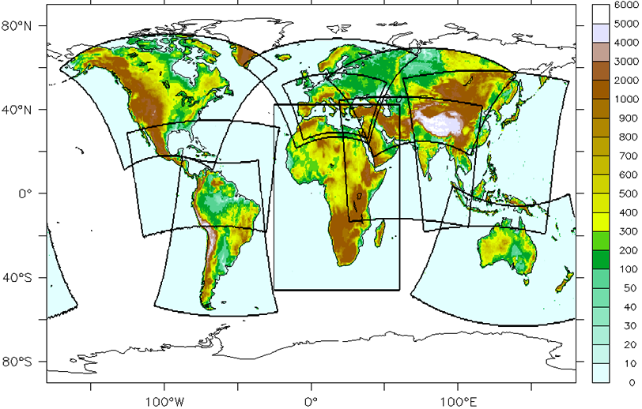
Active CORDEX Collaborations
Jet Propulsion Laboratory
California Institute of Technology
*
*
*
*
*
*
rcmes.jpl.nasa.gov

Slide 6
Observations
Remote Sensing, In Situ, Reanalysis
Jet Propulsion Laboratory
California Institute of Technology
Temperature (AIRS, CRU, UDEL)
Precipitation (TRMM, CRU, UDEL, CPC, GPCP)
Radiation/clouds (CERES, MODIS)
Sea surface height (AVISO)
Sea surface temperature (AMSRE)
Winds (QuikSCAT)
Multivariate reanalysis (MERRA, NARR, NLDAS ERA-Interim)
More to come…
Please see poster by Kim Whitehall today for further details
rcmes.jpl.nasa.gov

Slide 7
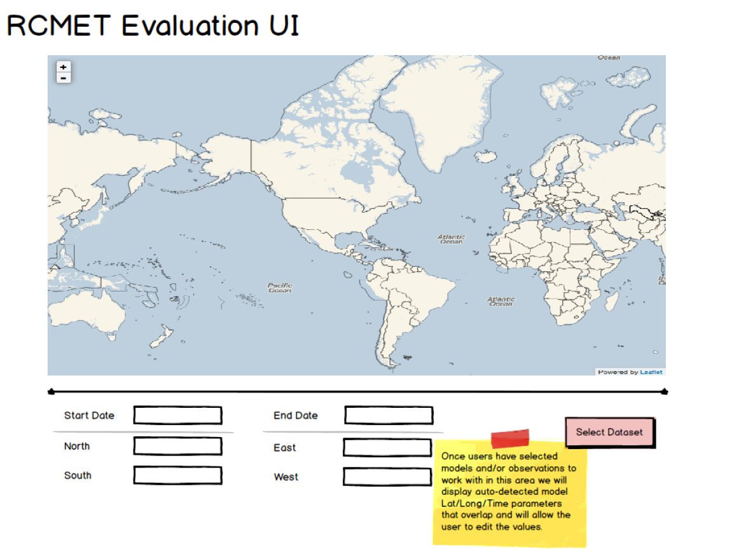
Jet Propulsion Laboratory
California Institute of Technology
See youtube video:
http://rcmes.jpl.nasa.gov/training/videos
rcmes.jpl.nasa.gov

Slide 8
RCMES Architecture
(http://rcmes.jpl.nasa.gov; Powered by Apache Open Climate Workbench)
Other Data Centers
(ESGF, DAAC, ExArch Network)
Model data
User
input
URL
TRMM
Metadata
Extract OBS data
Extract model data
MODIS
Data Table
Regridder
(Put the OBS & model data on the same time/space grid)
Data Table
Use the re-gridded data for user’s own analyses and VIS.
AIRS
Extractor for various data formats
Cloud Database
Data Table
Data extractor
(Binary or netCDF)
CERES
Data Table
Analyzer
Calculate evaluation metrics & assessment model input data
Soil moisture
Data Table
Data Table
Common Format,
Native grid,
Efficient architecture
Assess. modeling
ETC
Visualizer
(Plot the metrics)
Raw Data:
Various sources, formats,
Resolutions,
Coverage
RCMED
(Regional Climate Model Evaluation Database)
A large scalable database to store data from variety of sources in a common format
RCMET
(Regional Climate Model Evaluation Tool)
A library of code for extracting data from RCMED and model and for calculating evaluation metrics
Notes:
The standard RCMES diagram with some enhancements from Jinwon.

Slide 9
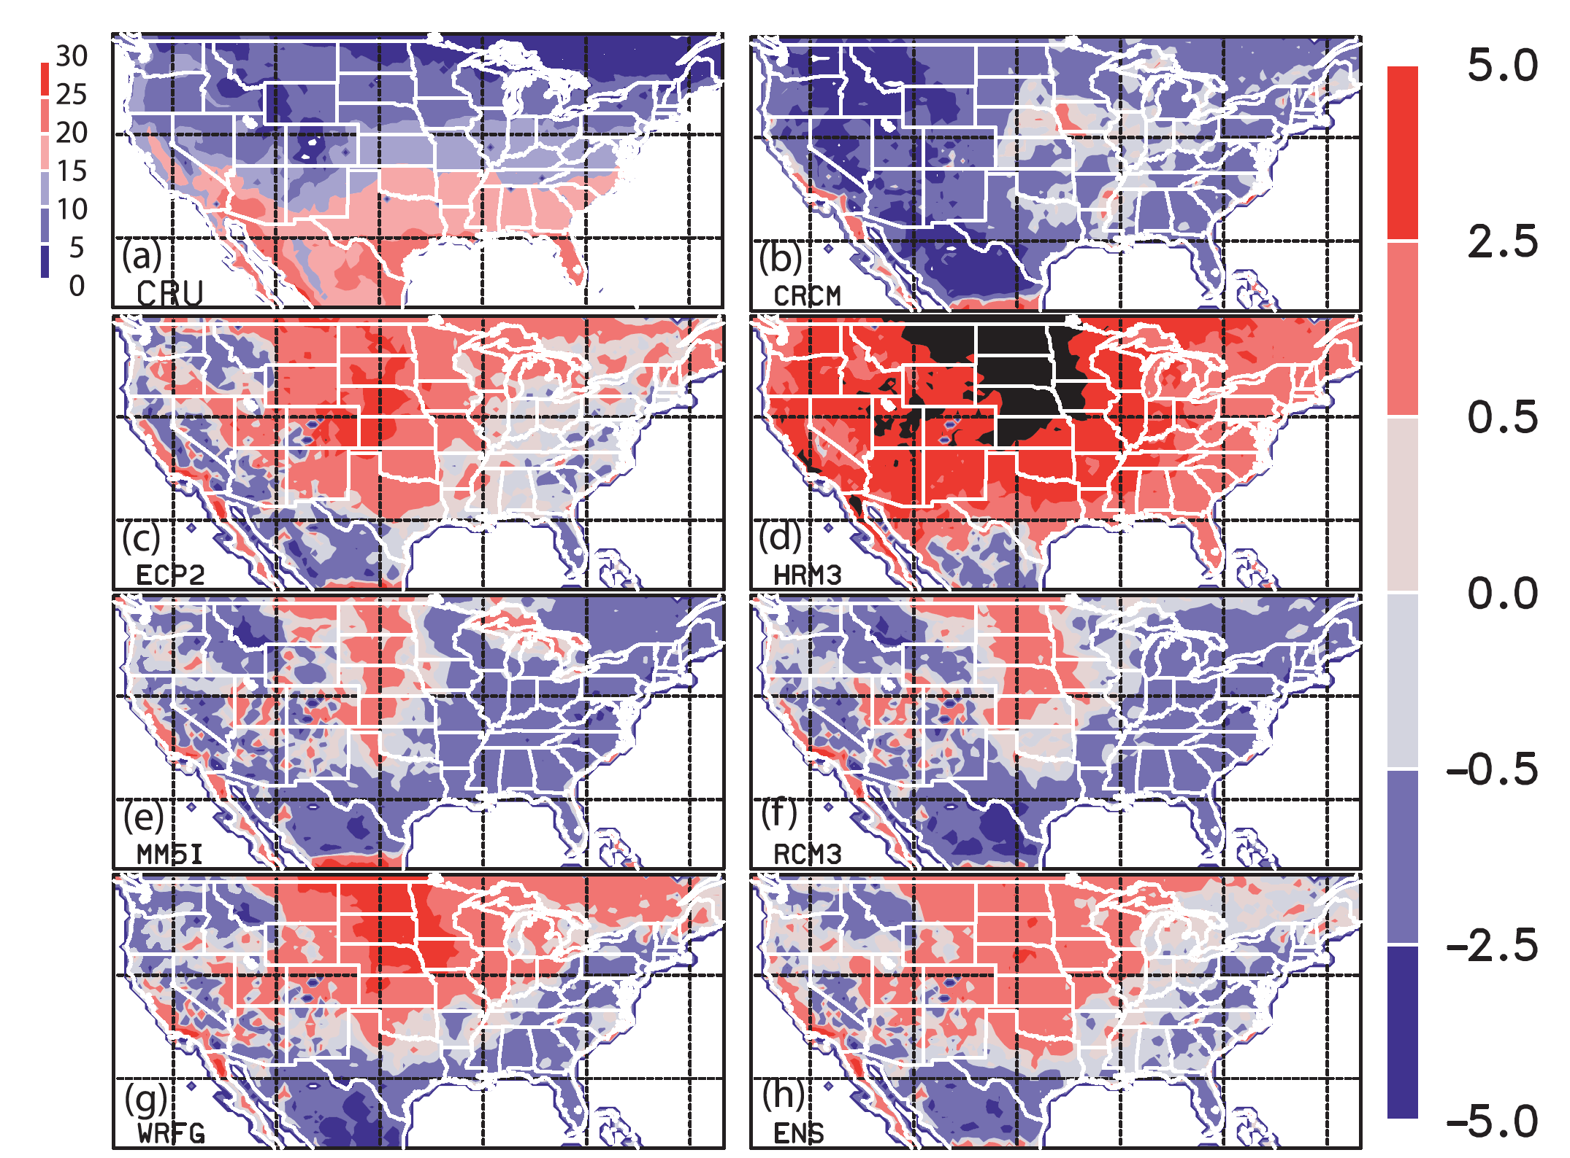
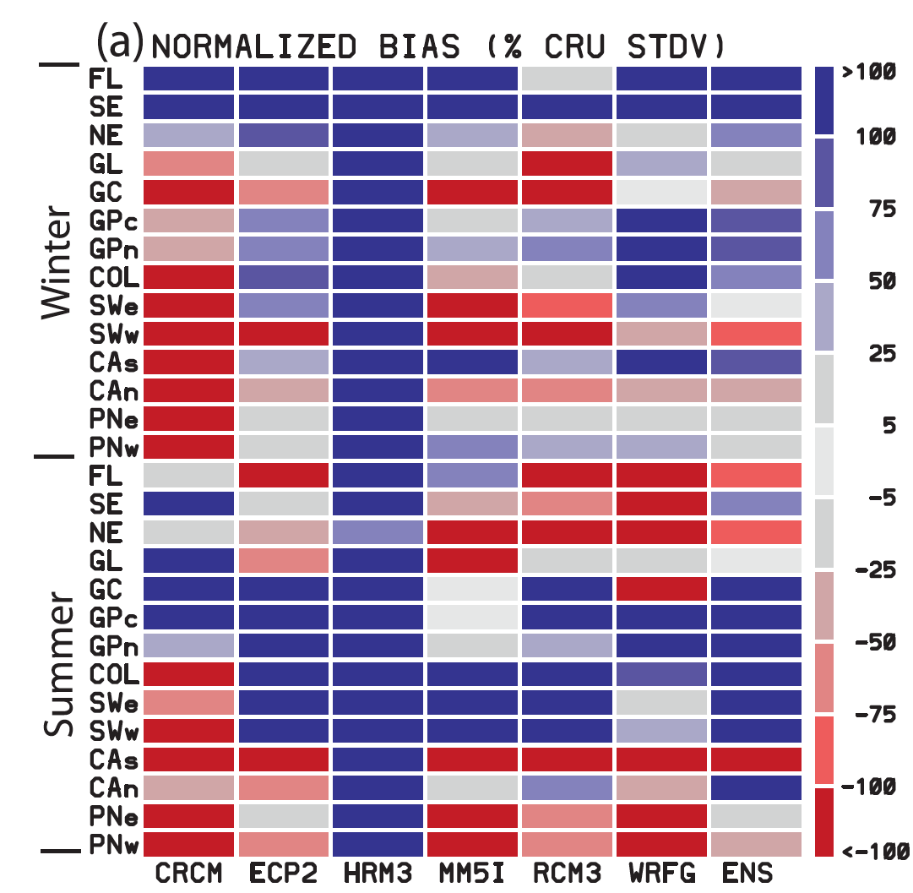
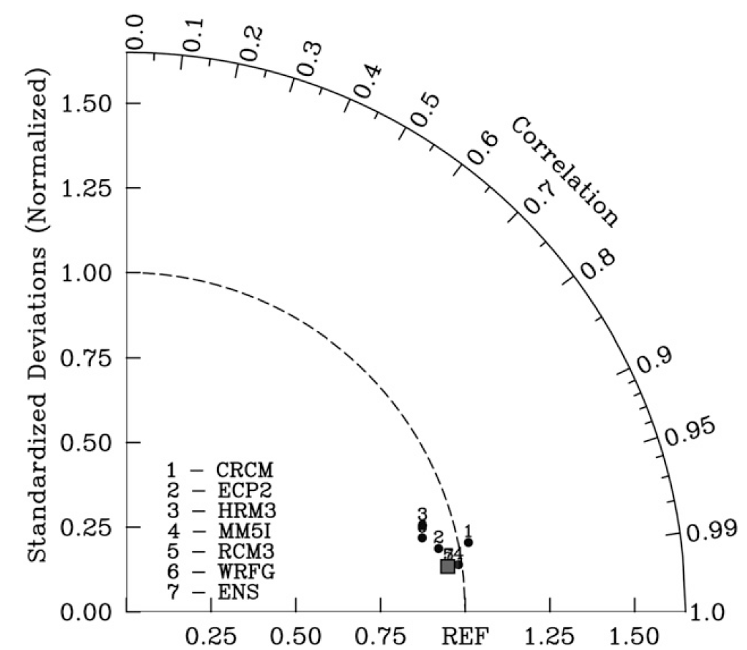
Metrics and Visualizations: NARCCAP Temperature Bias
Jet Propulsion Laboratory
California Institute of Technology
Bias Maps
Portrait Diagrams
Taylor Diagrams
Kim, J., D. E. Waliser, C. A. Mattmann, L. O. Mearns, C. E. Goodale, A. F. Hart, D. J. Crichton, S. McGinnis, H. Lee, P. C. Loikith, and M. Boustani, 2013: Evaluation of the Surface Air Temperature, Precipitation, and Insolation over the Conterminous U.S. in the NARCCAP Multi-RCM Hindcast Experiment Using RCMES, J. Climate, 26, 5698-5715.
rcmes.jpl.nasa.gov

Slide 10
RCMES Architecture
(http://rcmes.jpl.nasa.gov; Powered by Apache Open Climate Workbench)
Other Data Centers
(ESGF, DAAC, ExArch Network)
Model data
User
input
URL
TRMM
Metadata
Extract OBS data
Extract model data
MODIS
Data Table
Regridder
(Put the OBS & model data on the same time/space grid)
Data Table
Use the re-gridded data for user’s own analyses and VIS.
AIRS
Extractor for various data formats
Cloud Database
Data Table
Data extractor
(Binary or netCDF)
CERES
Data Table
Analyzer
Calculate evaluation metrics & assessment model input data
Soil moisture
Data Table
Data Table
Common Format,
Native grid,
Efficient architecture
Assess. modeling
ETC
Visualizer
(Plot the metrics)
Raw Data:
Various sources, formats,
Resolutions,
Coverage
RCMED
(Regional Climate Model Evaluation Database)
A large scalable database to store data from variety of sources in a common format
RCMET
(Regional Climate Model Evaluation Tool)
A library of code for extracting data from RCMED and model and for calculating evaluation metrics
Notes:
The standard RCMES diagram with some enhancements from Jinwon.

Slide 11
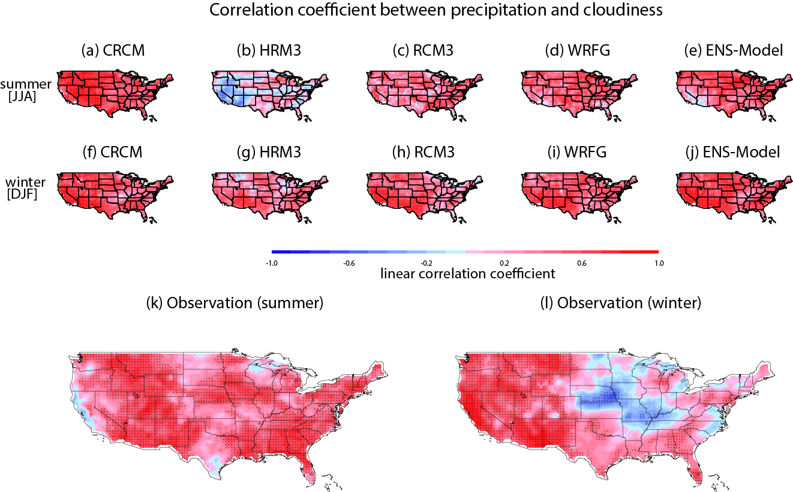
NARCCAP Cloud-precipitation-radiation relationship
Jet Propulsion Laboratory
California Institute of Technology
Poor agreement for HRM3
Lee, H., J. Kim, D. E. Waliser, P. C. Loikith, C. A. Mattmann, and S. McGinnis, Evaluation of simulation fidelity for precipitation, cloud fraction and insolation in the North America Regional Climate Change Assessment Program (NARCCAP), submitted to J. Geophys. Res., August, 2013.
rcmes.jpl.nasa.gov

Slide 12
Evaluation of NARCCAP Temperature PDFs and Extremes
Jet Propulsion Laboratory
California Institute of Technology
Skewness=-1
Most models reproduce boundary between primarily positive and negative skewness well
Skewness is primarily positive in north where large warm temperature excursions occur due to infrequent warm advection from south, these are not possible on cold tail
Coherent area of negative skewness from Pacific Ocean to Great Lakes is well simulated
Observational uncertainty low-NARR and MERRA agree well
Surface temperature skewness
Loikith, P. C., D. E. Waliser, J. Kim, H. Lee, B. R. Lintner, J. D. Neelin, S. McGinnis, C. Mattmann, and L. O. Mearns, Surface Temperature Probability Distributions in the NARCCAP Hindcast Experiment: Evaluation Methodology, Metrics and Results, submitted to J. Climate, July 2013.
rcmes.jpl.nasa.gov

Slide 13
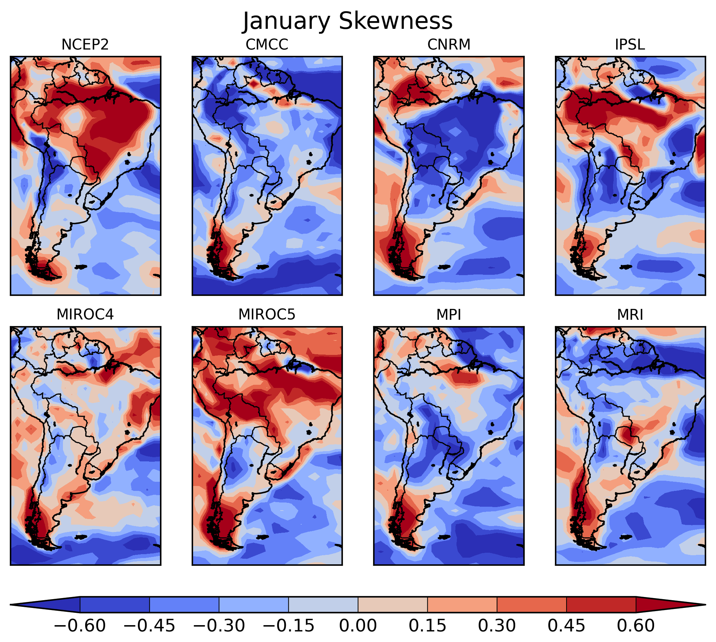
Skewness of January Surface Temperature
Jet Propulsion Laboratory
California Institute of Technology
RCMES allows for regional analysis of global models
Possible to compare CMIP5 simulations to CORDEX downscaled model simulations
Results show substantial model-reanalysis disagreement in daily temperature skewness
Suggestive of improper simulation of temperature extremes where disagreement is high
rcmes.jpl.nasa.gov

Slide 14
Future Direction
Observations and metrics continue to be added to RCMES
  Community can contribute to RCEMT via the Apache Open Climate Workbench (http://climate.incubator.apache.org/)
Regional Evaluation of CMIP5, including linkage to ESGF
Developing new and novel evaluation metrics for the evaluation
  Large-scale meteorological patterns associated with extremes
  Using k-means clustering to evaluate temperature PDFs
  Develop optimal multi-model ensemble techniques
Expanding user community and fostering new collaborations within CORDEX
Please see poster by Kim Whitehall today for further details
rcmes.jpl.nasa.gov

Slide 15
How do I get RCMES?
Jet Propulsion Laboratory
California Institute of Technology
General information: rcmes.jpl.nasa.gov
Download RCMES virtual machine
  rcmes.jpl.nasa.gov/training/downloads
Open source at Apache Open Climate Workbench
  http://climate.incubator.apache.org/
General inquiries please email: rcmes-general@jpl.nasa.gov
Please see poster by Kim Whitehall today for further details

Slide 16
Thank you!
Jet Propulsion Laboratory
California Institute of Technology
Contact information:
Paul Loikith: paul.c.loikith@jpl.nasa.gov
Duane Waliser: duane.e.waliser@jpl.nasa.gov (science PI)
Chris Mattmann: chris.a.mattmann@jpl.nasa.gov (IT PI)
  General questions: rcmes-general@jpl.nasa.gov
Websites:
rcmes.jpl.nasa.gov
rcmes.jpl.nasa.gov/downloads
  http://climate.incubator.apache.org/
Please see poster by Kim Whitehall today for further details
Questions?

