Slide 1


Statistical Downscaling using the Regional Climate Model Evaluation System (RCMES)
Jet Propulsion Laboratory
California Institute of Technology
RCMES team at Jet Propulsion Laboratory
APEC Climate Center Training Program 2014
Busan, South Korea
August 29, 2014
http://rcmes.jpl.nasa.gov
http://climate.apache.org
Courtesy of Dr. Paul Loikith

Slide 2
Today’s Agenda
9:00-9:50: Welcome and introduction to RCMES and statistical downscaling tools
10:00-11:00: RCMES demo and installation
11:00-13:00: Activity #1: Compare four different downscaling approaches
13:00-14:00: Lunch
14:00-15:00: Group discussion of Activitiy #1 results
15:00-17:00: Activity #2: Compare climate change scenarios (RCP 4.5 vs. RCP 8.5)
17:00-18:00: Group discussion of Activitiy #2 results
18:00 : Adjourn

Slide 3
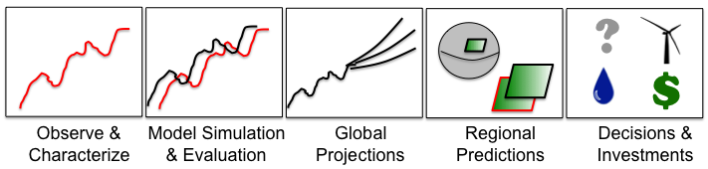
RCMES Motivation & Goals
GOALS
RCMES
  Make observation datasets, with some emphasis on satellite data, more accessible to the RCM community.
  Make the evaluation process for regional climate models simpler, quicker and physically more comprehensive.
  Provide researchers more time to spend on analysing results and less time coding and worrying about file formats, data transfers, etc.
BENEFITS
    Quantify model strengths/weaknesses for development/improvement efforts
    Improved understanding of uncertainties in predictions

Slide 4
The Regional Climate Model Evaluation System (RCMES)
Joint collaboration: JPL/NASA, UCLA
Two main components
  Database of observations
  Toolkit for model evaluation and statistical downscaling
Python-based open source software powered by the Apache Open Climate Workbench (OCW)

Slide 5
Meet the RCMES Team
Climate Science Team:
Duane Waliser (PI, JPL/Caltech, UCLA), Paul Loikith (JPL/Caltech), Huikyo Lee (JPL/Caltech), Jinwon Kim (UCLA), Kim Whitehall (Howard University),
Danielle Groenen (Florida State University)
Computer Science/Development Team:
Chris Mattmann (PI, JPL/Caltech, UCLA), Paul Ramirez (JPL/Caltech),
Cameron Goodale (JPL/Caltech), Michael Joyce (JPL/Caltech),
Maziyar Boustani (JPL/Caltech), Andrew Hart (JPL/Caltech),
Shakeh Khudikyan (JPL/Caltech),
Jesslyn Whittel (University of California, Berkeley),
Alex Goodman (Colorado State University)
rcmes.jpl.nasa.gov

Slide 6
Regional Climate Model Evaluation System
High-Level Architecture
Other Data Centers
(ESG, DAAC, ExArch Network)
User
input
Model data
URL
TRMM
Metadata
Extract OBS data
Extract model data
MODIS
Data Table
Regridder
(Put the OBS & model data on the same time/space grid)
Extractor for various data formats
Data Table
Use the re-gridded data for user’s own analyses and VIS.
AIRS
Data Table
PostgreSQL
Data extractor
(Binary or netCDF)
CERES
Data Table
Metrics Calculator
(Calculate evaluation metrics)
Soil moisture
Data Table
Data Table
Common Format,
Native grid,
Efficient architecture
Visualizer
(Plot the metrics)
ETC
Raw Data:
Various sources, formats,
Resolutions,
Coverage
RCMED
(Regional Climate Model Evaluation Database)
A large scalable database to store data from variety of sources in a common format
RCMET
(Regional Climate Model Evaluation Toolkit)
A library of codes for extracting data from RCMED and model and for calculating evaluation metrics
RCMES
High-level technical architecture
RCMES
High-level technical architecture
user
choice
RCM data
user
choice
RCM data
URL
TRMM
Metadata
URL
Extract OBS data
Extract RCM data
TRMM
Metadata
Extract OBS data
Extract RCM data
Data Table
User’s own codes for ANAL and VIS.
MODIS
Data Table
User’s own codes for ANAL and VIS.
MODIS
Data Table
Regridder
Put the OBS & RCM data on the same grid for comparison
Data Table
Regridder
Put the OBS & RCM data on the same grid for comparison
AIRS
Extractor
MySQL
AIRS
Extractor
MySQL
Data Table
Data extractor
(Fortran binary)
Data Table
Data extractor
(Fortran binary)
SWE
Data Table
Metrics Calculator
Calculate comparison metrics
SWE
Data Table
Metrics Calculator
Calculate comparison metrics
Soil moisture
Data Table
Data extractor
(Fortran binary)
Soil moisture
Data Table
Data extractor
(Fortran binary)
Data Table
Data Table
Visualizer
Plot the metrics
ETC
Common Format,
Native grid,
Efficient architecture
Visualizer
Plot the metrics
ETC
Common Format,
Native grid,
Efficient architecture
Raw Data:
Various Formats,
Resolutions,
Coverage
RCMED
(Regional Climate Model Evaluation Database)
A large scalable database to store data in a common format
RCMET
(Regional Climate Model Evaluation Toolkit)
A library of codes for extracting data from RCMED and model and for calculating evaluation metrics
Raw Data:
Various Formats,
Resolutions,
Coverage
RCMED
(Regional Climate Model Evaluation Database)
A large scalable database to store data in a common format
RCMET
(Regional Climate Model Evaluation Toolkit)
A library of codes for extracting data from RCMED and model and for calculating evaluation metrics

Slide 7
Regional Climate Model Evaluation Database (RCMED)
Remote Sensing, In Situ, Reanalysis
Temperature (AIRS, CRU, UDEL)
Precipitation (TRMM, CRU, UDEL, CPC, GPCP)
Radiation/clouds (CERES, MODIS)
Sea surface height (AVISO)
Sea surface temperature (AMSRE)
Winds (QuikSCAT)
Multivariate reanalysis (MERRA, NARR, NLDAS, ERA-Interim)
Snow Water Equivalent (SNODAS)
Evapotranspiration (RHEAS)
More to come…

Slide 8
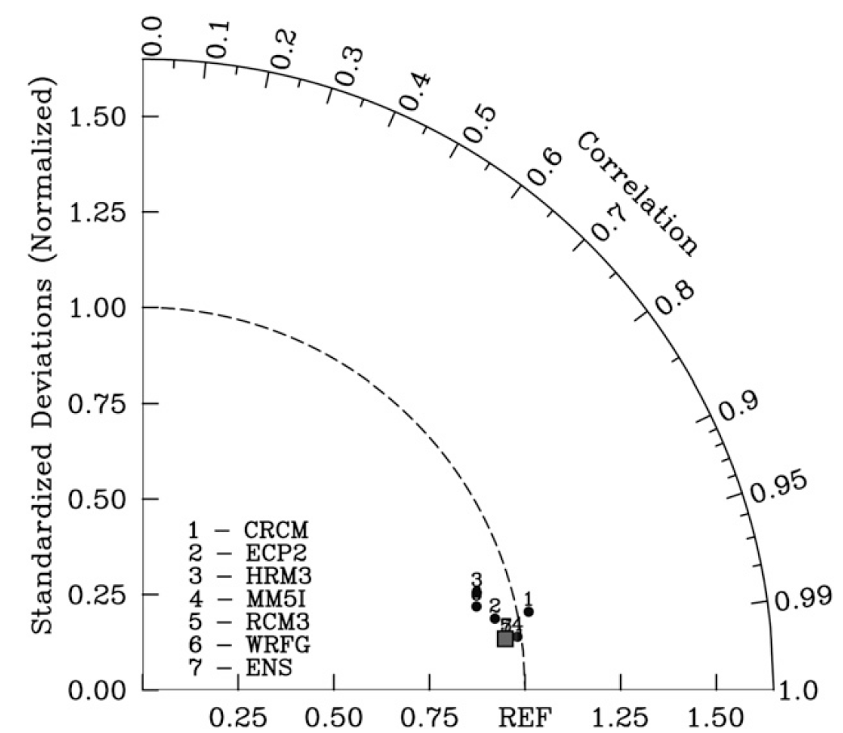
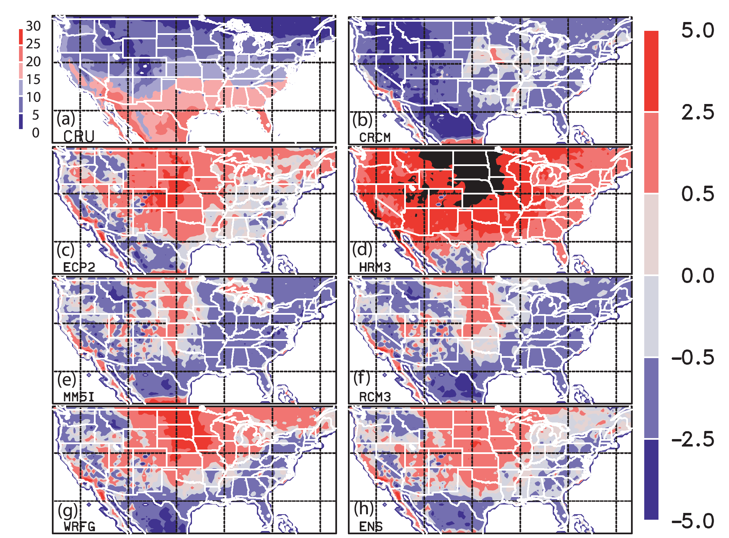
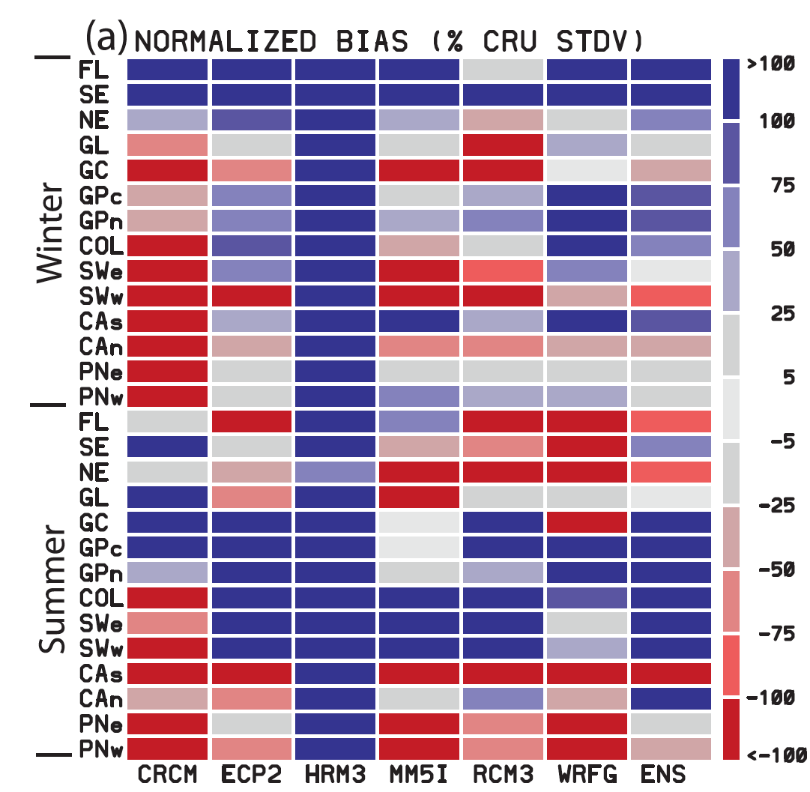
Regional Climate Model Evaluation Toolkit (RCMET)
Subset data temporally and spatially
Interpolates observations and models to common grid
  User defined
  Bi-linear, scipy.interpolate.griddata
Computes and visualizes commonly used metrics (bias, Taylor Diagrams, etc.)
RCMET is built as a Python library with a growing number of useful functions to facilitate model evaluation and statistical downscaling.
Bias Maps
Portrait Diagrams
Taylor Diagrams
Kim, J., D. E. Waliser, C. A. Mattmann, L. O. Mearns, C. E. Goodale, A. F. Hart, D. J. Crichton, S. McGinnis, H. Lee, P. C. Loikith, and M. Boustani, 2013: Evaluation of the Surface Air Temperature, Precipitation, and Insolation over the Conterminous U.S. in the NARCCAP Multi-RCM Hindcast Experiment Using RCMES, J. Climate, 26, 5698-5715.

Slide 9
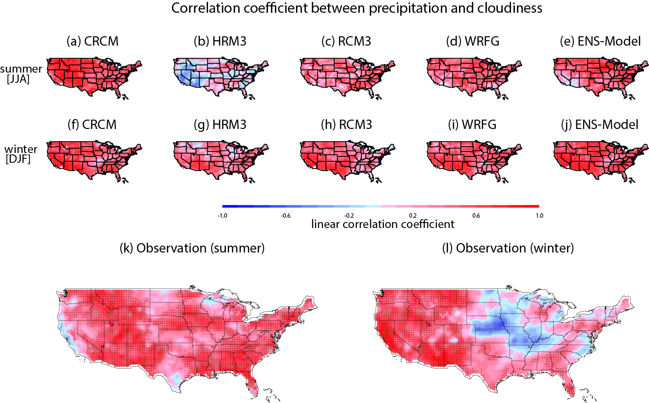
NARCCAP Cloud-precipitation-radiation relationship
Poor agreement for HRM3
Lee, H., J. Kim, D. E. Waliser, P. C. Loikith, C. A. Mattmann, and S. McGinnis (2014), Evaluation of simulation fidelity for precipitation, cloud fraction and insolation in the North America Regional Climate Change Assessment Program (NARCCAP).
rcmes.jpl.nasa.gov

Slide 10
Evaluation of NARCCAP Temperature PDFs and Extremes
Skewness=-1
Most models reproduce boundary between primarily positive and negative skewness well
Skewness is primarily positive in north where large warm temperature excursions occur due to infrequent warm advection from south, these are not possible on cold tail
Coherent area of negative skewness from Pacific Ocean to Great Lakes is well simulated
Observational uncertainty low-NARR and MERRA agree well
Surface temperature skewness
Loikith, P. C., D. E. Waliser, J. Kim, H. Lee, B. R. Lintner, J. D. Neelin, S. McGinnis, C. Mattmann, and L. O. Mearns, Surface Temperature Probability Distributions in the NARCCAP Hindcast Experiment: Evaluation Methodology, Metrics and Results, under review for J. Climate.
rcmes.jpl.nasa.gov

Slide 11
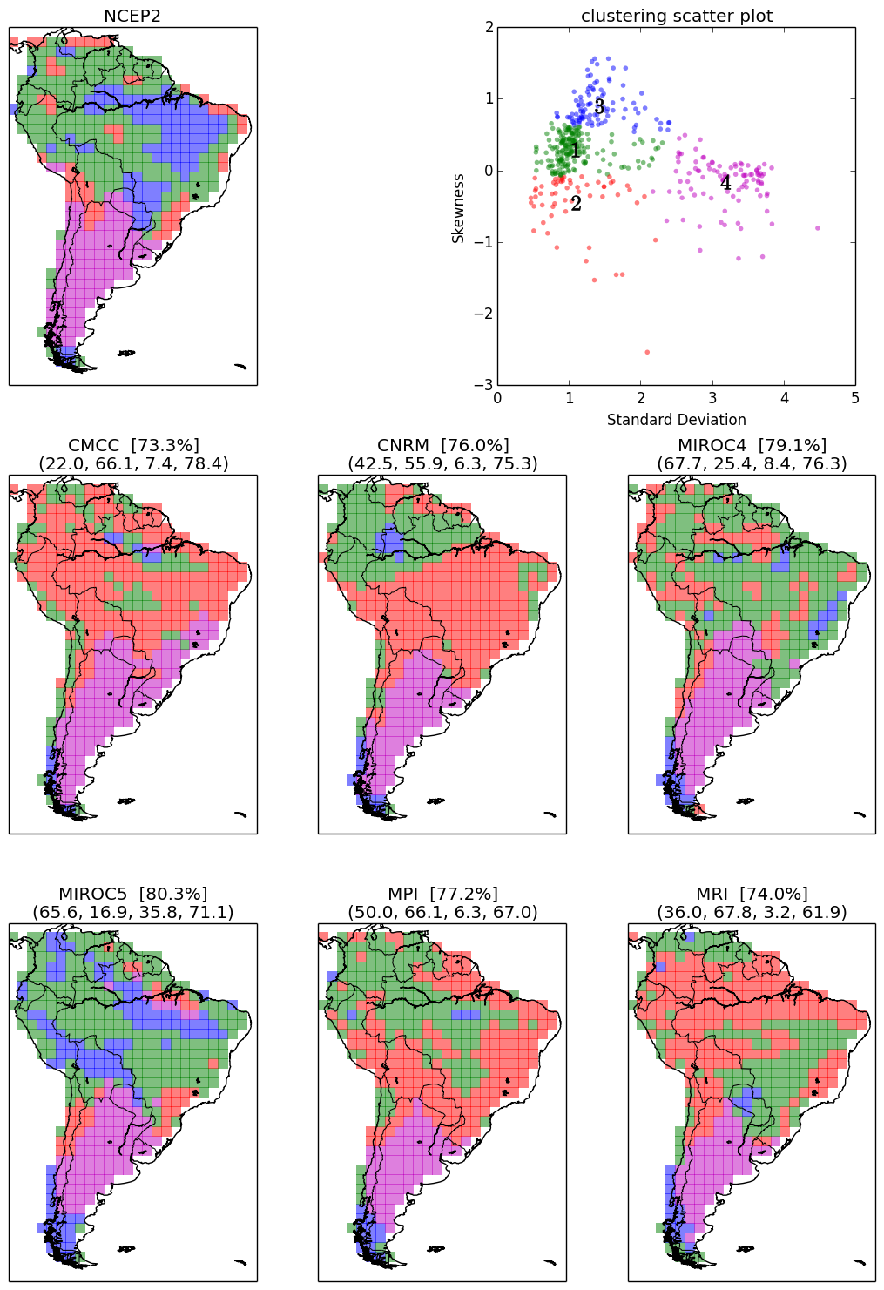
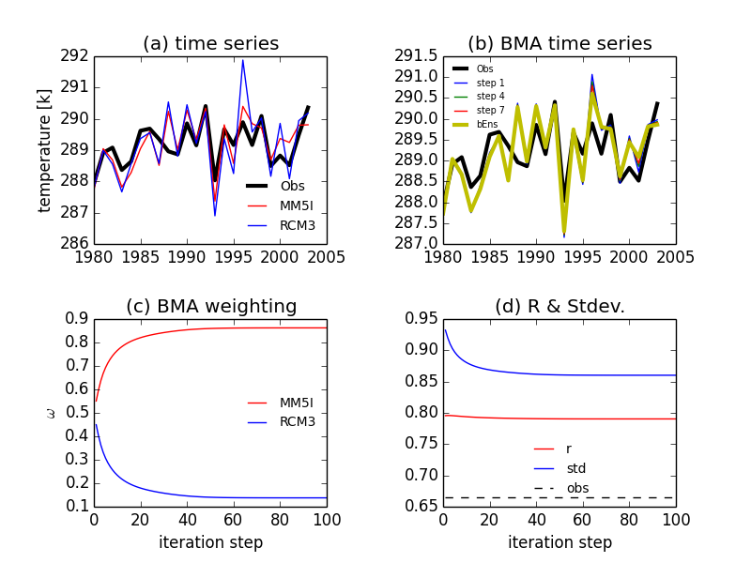
Ongoing Model Evaluation Studies
Not just for RCMs, CMIP data too!
Bayesian model averaging for optimal multi-model ensemble configurations.
(Huikyo Lee - lead)
Large scale meteorological patterns associated with temperature extremes over North America (Paul Loikith - lead )
K-means clustering to evaluate surface temperature variance and skewness over South America (Huikyo Lee - lead).

Slide 12
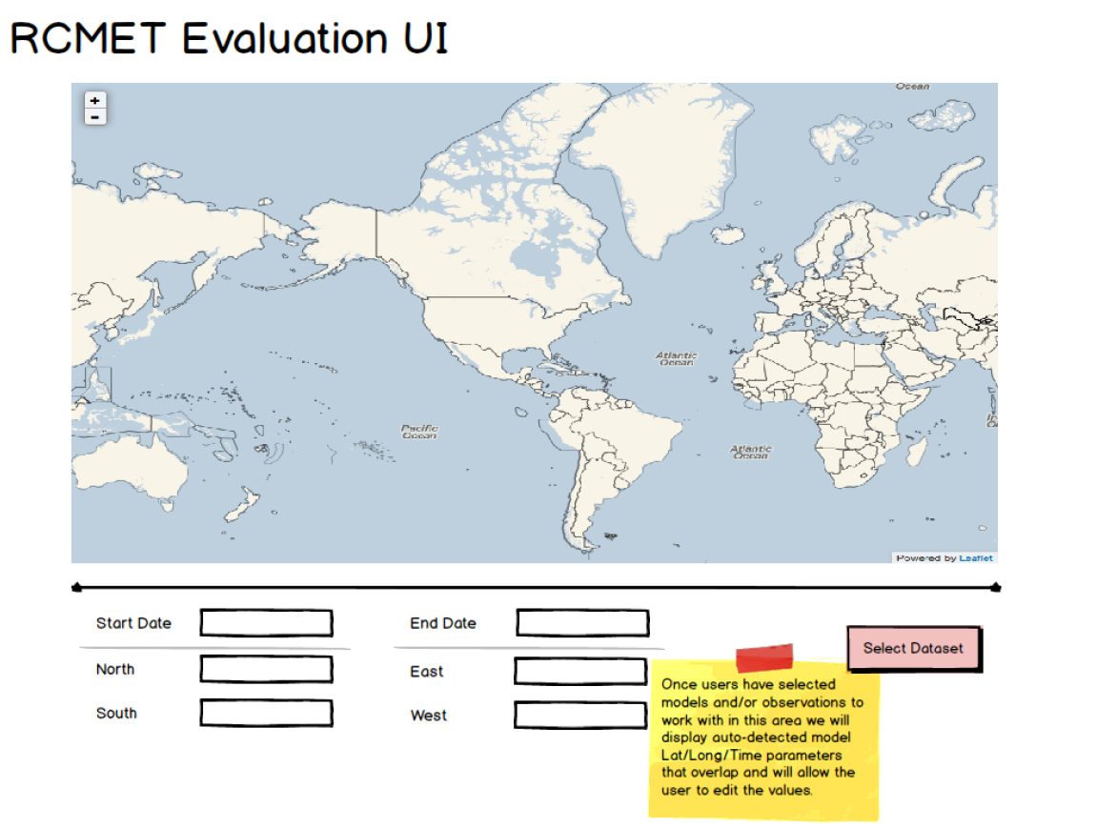
Ways to Use RCMES
RCMES in a virtual machine environment
  Downloadable from rcmes.jpl.nasa.gov/downloads
  Comes with all Python libraries and dependencies installed
RCMES on Mac or Linux machine
  Source code downloadable from http://climate.incubator.apache.org/
  Requires all necessary Python libraries installed on local machine
Can interact programmatically or with a point and click user interface.

Slide 13
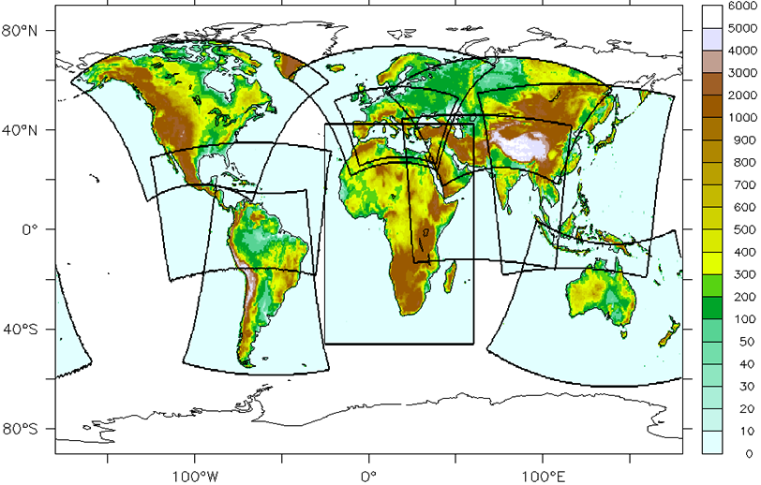
CORDEX Interactions & Support
N. America –NARCCAP via NCAR/Mearns for U.S. NCA
Africa – collaboration with UCT/Hewitson & Rossby Ctr/Jones
E. Asia – exploring collaboration with KMA & APCC, particip. in Sep’11 & Nov’12 mtgs
S. Asia – collaboration with IITM/Sanjay, participated Oct’12 & Sep’13 mtgs.
Arctic – participated in initial Mar’12 mtg and Nov’13 and Jun’14
Caribbean, S. America –participated in 1st major mtg Sep’13 and 2nd Apr’14
Middle East – N. Africa –participating in initial coordinating team and Friday’s mtg
Typically try to support meetings by sending a climate scientist and an IT expert, provide an overview and a tutorial/training.
Have hosted scientists & students at JPL/UCLA
Learning RCM User Needs
Infusing Support into
CORDEX

Slide 14
Future Direction
Development is ongoing…
  Expansion of database
  Adding more metrics and downscaling methods to RCMET
  Growing user and developer base
Connection to Earth System Grid Federation (ESGF)
Improving user experience

Slide 15
Why do we need to downscale GCM outputs?
Global climate models (GCMs) cannot simulate climate at the local to regional scale.
Most of downscaling studies in the United States have used one of five methods [Stoner et al., 2013].
  dynamical downscaling: simulation of regional climate models (RCMs).
  delta method
  bias correction – spatial disaggregation (BCSD)
  asynchronous regression approach
  bias corrected constructed analogue (BCCA)

Slide 16
Statistical downscaling
Advantages | Disadvantages
Relatively easy to produce (even using your laptops) Impact-relevant variables not simulated by climate models can be downscaled. | assumptions of stationarity between the large and small scale dynamics small scale dynamics and climate feedbacks are not reflected.
(http://www.glisaclimate.org/)

Slide 17
Statistical downscaling using RCMES
Four different methods
  Delta method (addtion)
  Delta method (bias correction)
  Quantile mapping
  Asynchronous linear regression
RCMES database provides observational data to determine the observation-model relationship.

Slide 18
Data
NASA’s Tropical Rainfall Measuring Mission (TRMM) data: precipitation [mm/day], 0.25°x 0.25°, monthly, 1998-2013.
Climate Research Unit (CRU) data: mean/maximum/minimum temperatures near surface [K], precipitation [mm/day], 0.25°x 0.25°, monthly, 1998-2013.
Three CMIP5 model outputs (IPSL, MIROC5 and MPI) from the decadal 1980 experiment, RCP 4.5 and RCP 8.5 scenarios.
TRMM and CRU data can be downloaded from RCMED.

Slide 19
Spatial aggregation of observational data
Y₁
Y₂
grid boxes of observational data:
fine resolution
X₁
Y₄
Y₃
grid boxes of
model data:
coarse resolution
To downscale climate variables at a specific location (star marker), RCMET uses
  the nearest model grid point data (x₁), and
  observational data from surrounding grid points (y_{1,}y_{2,} y₃, y₄).

Slide 20
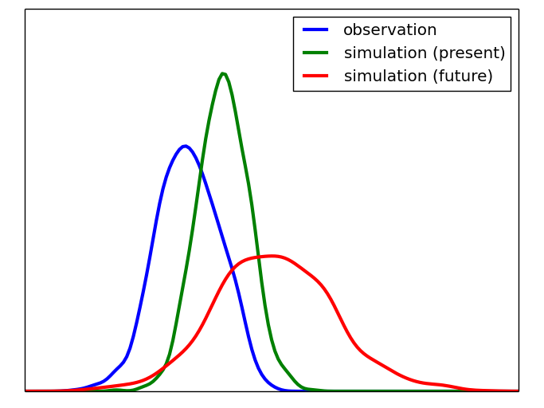
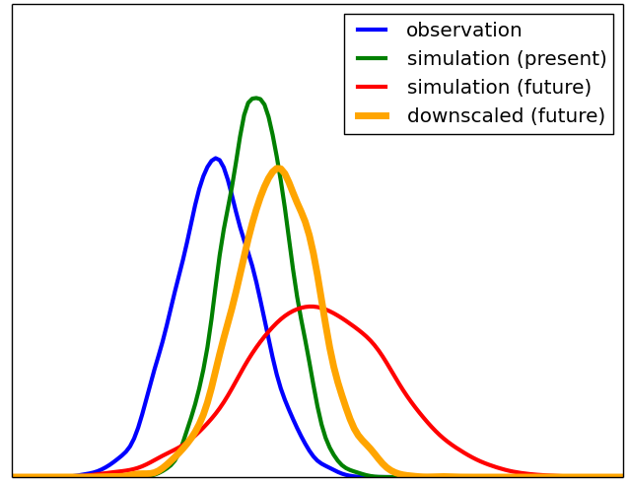
Delta method
(Delta addition)
(future climate) = (present observation) + (mean difference between Y₀ and Y₁)
delta
delta

Slide 21
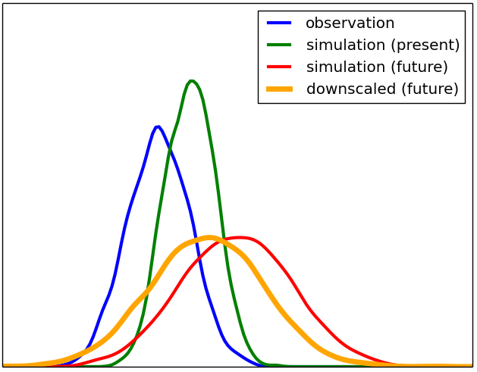
Delta method
(Bias correction)
(future climate) = (future simulation) + (mean bias)
bias
bias

Slide 22
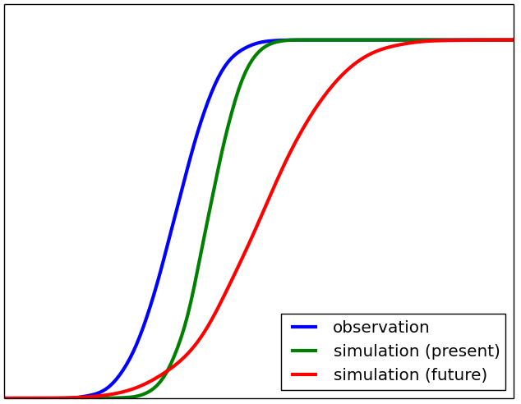
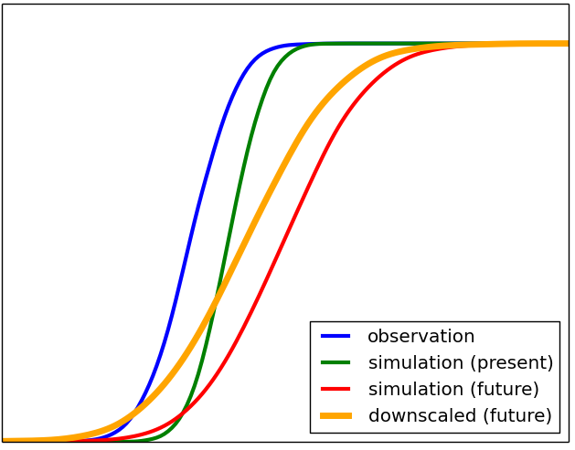
Quantile mapping
(future climate) = (bias corrected future simulation)
Bias is corrected for each quantile.
biases
biases

Slide 23
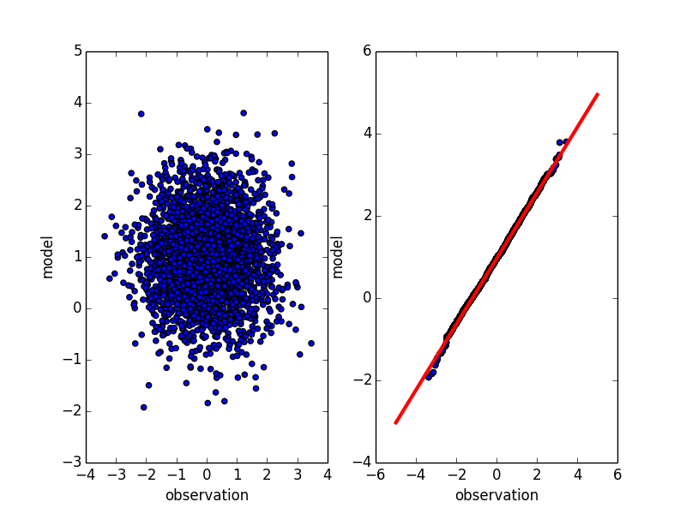
Asynchronous linear regression
The linear relationship between observation and present simulation is determined after sorting them in ascending order.

Slide 24
Are you ready to use RCMES on your laptop?
Please cOPY ‘APCC-training2014’ folder from the usb thumb drive to the desktop of your laptop.
?

Slide 25
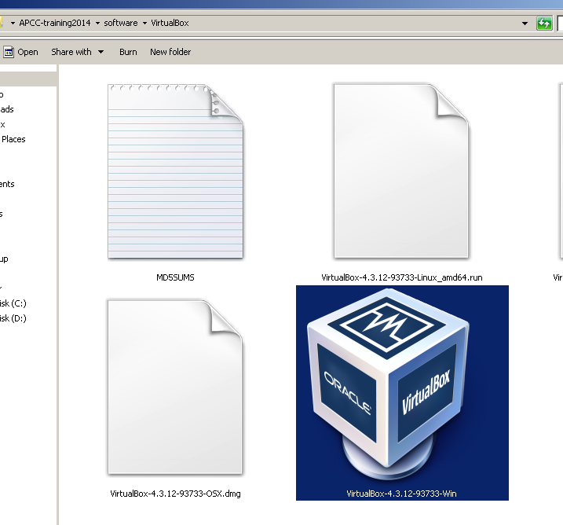
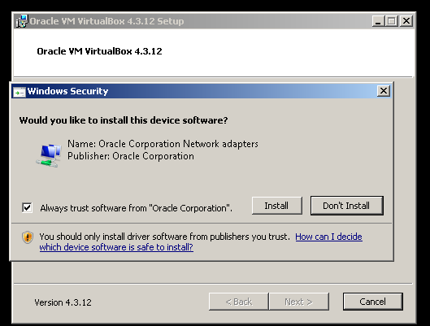
Installation of Virtual Box
(APCC-training2014/software/VirtualBox)
Virtual Box is free software.
It allows guest operating system to be loaded and run.
Our .ova file includes Linux OS, Python and RCMES software. So users can easily install and run RCMES regardless of their computers’ operating system.
Just double click XXX.ova after installing Virtual Box.
click ‘Install’

Slide 26
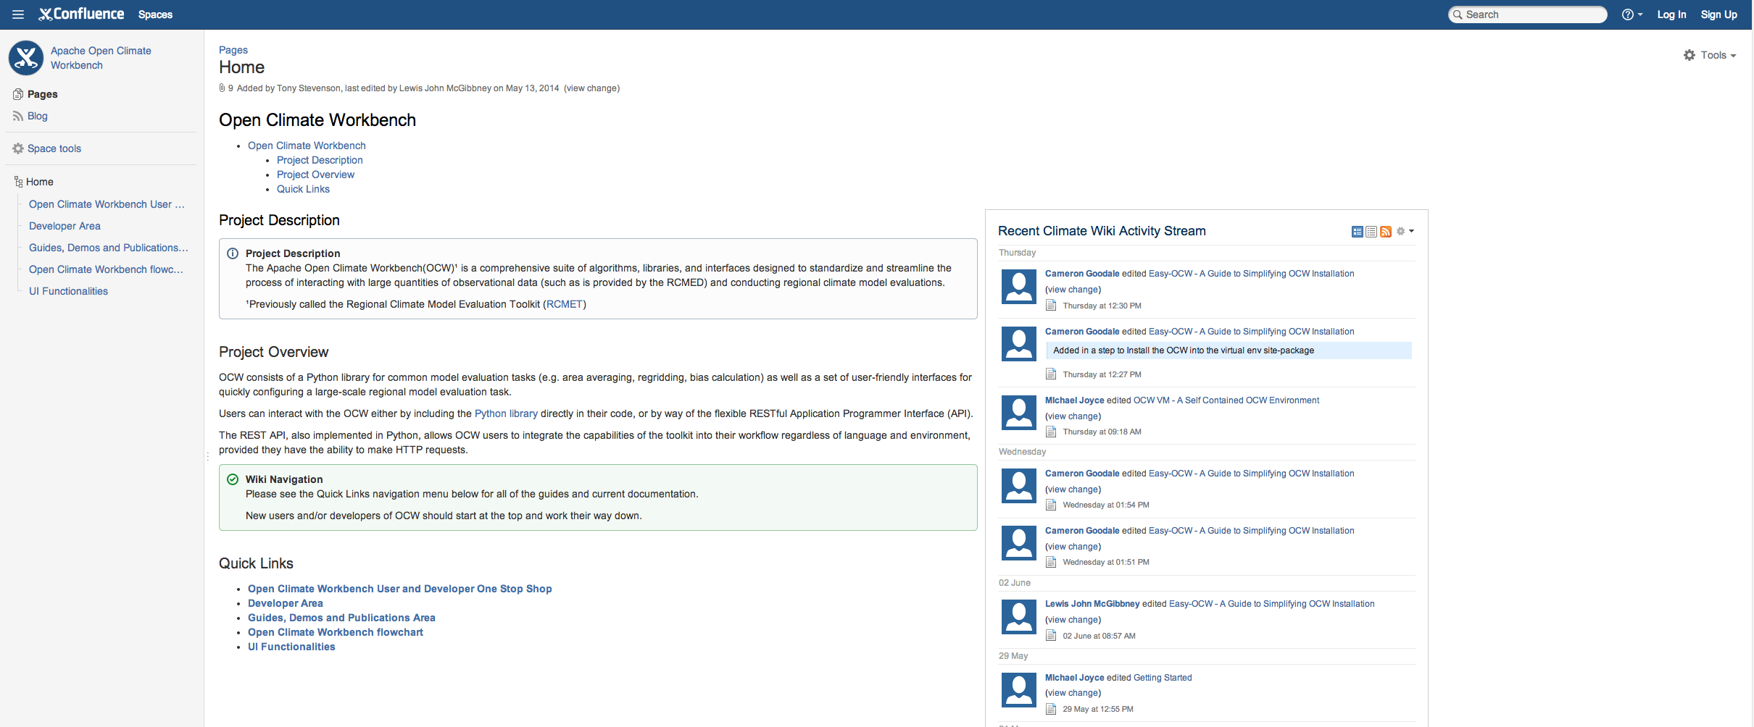
Installation without using Virtual Box (step-by-step)
https://cwiki.apache.org/confluence/display/CLIMATE/Home

Slide 27
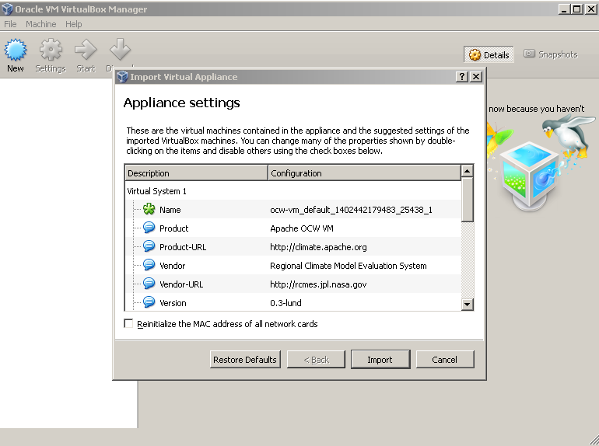
Click ‘Import’
click

Slide 28
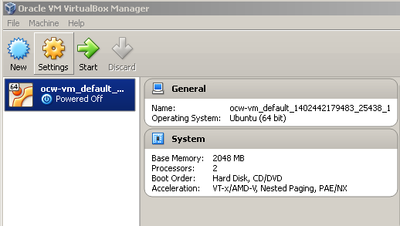
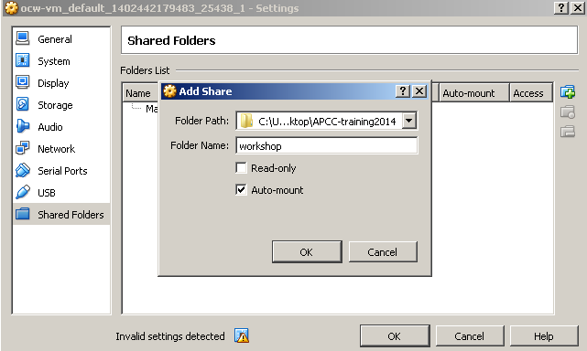
Setting up a shared folder between the virtual machine and your laptop
click
ID: vagrant
Password: vagrant

Slide 29
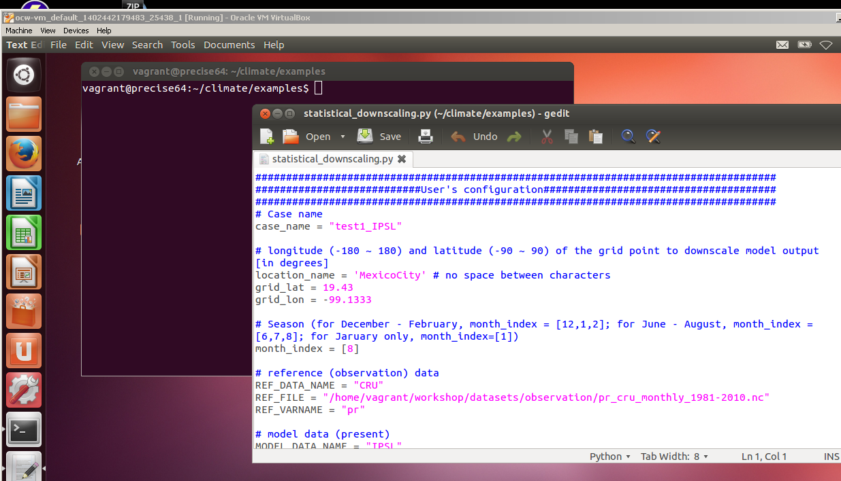
~/workshop/examples/statistical_downscaling.py

Slide 30
statistical_downscaling.py (1)
A folder named as ‘case_name’ is generated under the examples folder and saves all plots and results.
case_name = ‘Nairobi_DJF_tas’
location_name = ‘Nairobi'
# no space between characters
Search geographic coordinate of cities on Google.
(ex) latitude and longitude of Nairobi): 1.28S, 36.82E
grid_lat = -1.28
grid_lon = 36.82

Slide 31
statistical_downscaling.py (2)
To downscale simulated data in August,
month_index = [8]
To downscale simulated data from December through February,
month_index = [12, 1, 2]
# reference (observation) data
REF_DATA_NAME = "CRU"
REF_FILE = "/home/vagrant/workshop/datasets/observation/pr_cru_monthly_1981-2010.nc"
REF_VARNAME = "pr"

Slide 32
statistical_downscaling.py (3)
# model data (present)
MODEL_DATA_NAME = "IPSL"
MODEL_FILE = "/home/vagrant/workshop/datasets/model_present/pr_Amon_IPSL_decadal1980_198101-201012.nc"
MODEL_VARNAME = "pr"
# model data (future)
FUTURE_SCENARIO_NAME = "RCP4.5_2041-70"
MODEL_FILE2 = "/home/vagrant/workshop/datasets/model_rcp45/pr_Amon_IPSL_rcp45_204101-207012.nc"
# downscaling method (1: delta addition, 2: Delta correction, 3: quantile mapping, 4: asynchronous regression)
DOWNSCALE_OPTION = 1

Slide 33
Compile and run statistical downscaling
> python statistical_downscaling.py
You can access example/case_name folder on both your Virtual Box Linux and windows.
downscaling_location: map with a marker
histograms of the original and downscaled data
spreadsheet including downscaling location, months, observational and model data, and downscaled data

Slide 34
Activity #1: Compare four different downscaling approaches
Change ‘DOWNSCALE_OPTION’
  1: Delta addition: does not correct the simulation result for present climate
  2: Delta correction
  3: Quantile mapping
  4: Asynchronous linear regression

Slide 35
Activity #2: Compare climate change scenarios
Change ‘FUTURE_SCENARIO_NAME’ and ‘MODEL_FILE2’
  1: RCP 4.5 for 2041-2070
  2: RCP 4.5 for 2071-2100
  3: RCP 8.5 for 2041-2070
  4: RCP 8.5 for 2071-2100

Slide 36
References
About RCMES and OCW
  Mattmann et al. (2014), Cloud computing and virtualization within the Regional Climate Model and Evaluation System, Earth Science Informatics.
  Kim, J., et al. (2013), Evaluation of the surface air temperature, precipitation, and insolation over the conterminous U.S. in the NARCCAP multi-RCM hindcast experiment using RCMES, Journal of Climate.
  Whitehall et al. (2012), Building model evaluation and decision support capacity for CORDEX, WMO Bulletin.
  Crichton et al. (2012), Sharing Satellite Observations with the Climate-Modeling Community: Software and Architecture, Ieee Software.
About statistical downscaling
  Wood et al. (2004), Hydrologic implications of dynamical and statistical approaches to downscale climate model outputs, Climate Change.
  Stoner et al. (2013), An asynchronous regional regression model for statistical downscaling of daily climate variables, International Journal of Climatology.
  Maraun (2013), Bias correction, quantile mapping, and downscaling: revisiting the inflation issue, Journal of Climate.
  Juneng et al. (2010), Statistical downscaling forecasts for winter monsoon precipitation in Malaysia using multimodel output variables, Journal of Climate.
  O’Brien et al. (2001), Statistical asynchronous regression: Determining the relationship between two quantiles that are not measured simultaneously, Journal of Geophysical Research.

Slide 37
Where to find more information:
http://rcmes.jpl.nasa.gov
http://climate.apache.org/
Email team members or dev@climate.apache.org
Contacts:
Kyo Lee: huikyo.lee@jpl.nasa.gov

