Slide 1
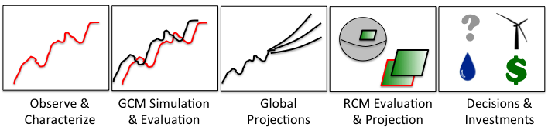
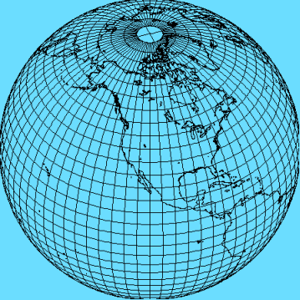

Developing a systematic set of observations, diagnostics/metrics and tools for evaluating Regional Climate Models
From Whitehall et al. 2012, WMO Bull.
Duane Waliser
Jet Propulsion Laboratory/Caltech
& University of California, Los Angeles
Chris Mattmann, Paul Loikith, Huikyo Lee, etc, JPL
Jinwon Kim, UCLA
Linda Mearns, NCAR
and many others, including a number of CORDEX domain working groups
RCMES.JPL.NASA.GOV

Slide 2

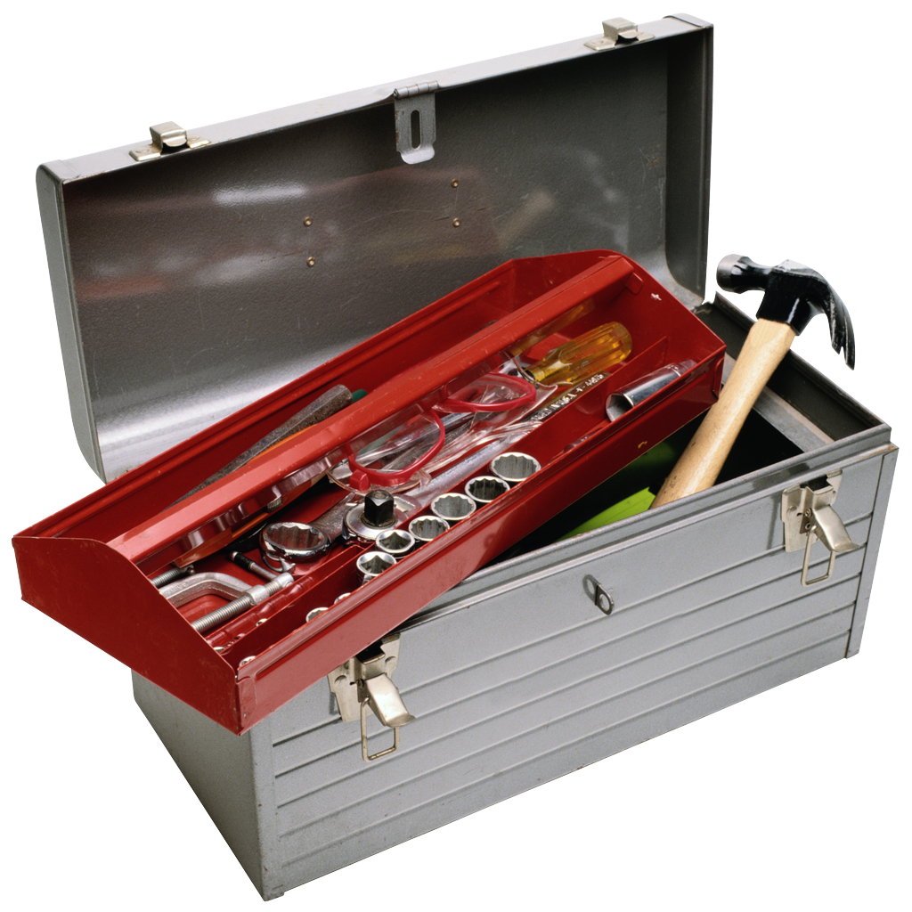
Essential Roles of Observations
Model Evaluation & Uncertainty Consideration/Quantification
Model Development, Improvement, Evaluation

Slide 3
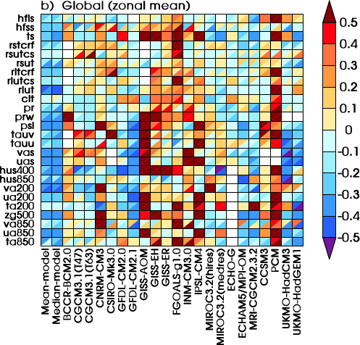
OBSERVATIONS: Model Evaluation & Uncertainty Consideration/Quantification
Decision
Space
Physical
Space
Climate Parameter
Probability
Observed Record
Future Projection
Climate Parameter
Ref Value
After “Scoring”
w/ Observations
Revised Decision
Space
Apply Metrics/Bias Correction
Climate Parameter
Probability
Observed Record
Future Projection
Climate Parameter
Gleckler et al. 2008
RMSE
Corrrelation

Slide 4
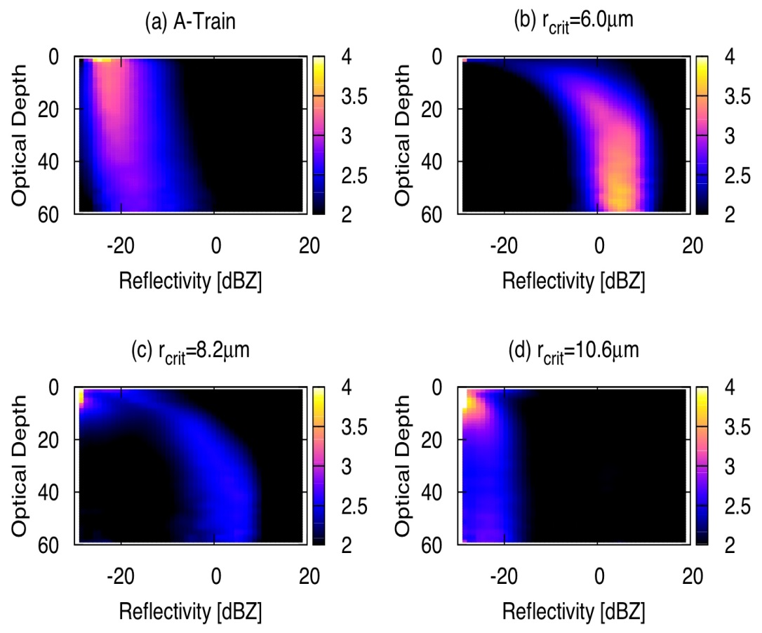
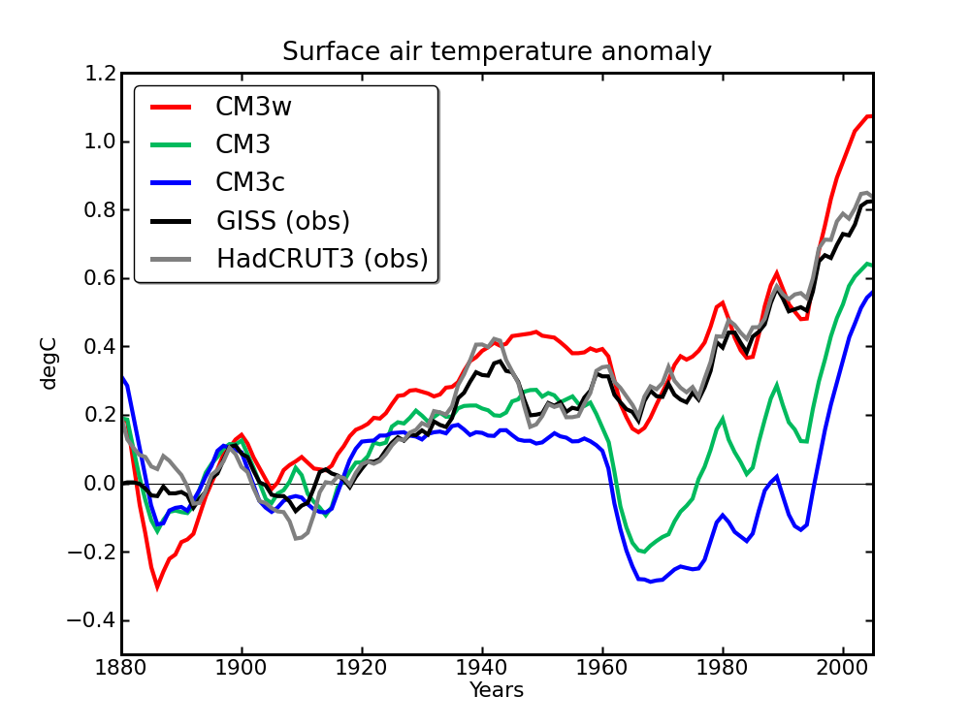
Observations: Model Development, Improvement, Evaluation
Sat Obs
r_{crit}=6.0μm
r_{crit}= 6.0μm
r_{crit}= 8.2μm
r_{crit}= 10.6μm
GFDL CM3
This sort of work needs to be more evident in RCM community for RCM-relevant scales and applications.
r_{crit}=8.2μm
r_{crit}=10.6μm
Golaz et al. (GRL’13)
Suzuki, Golaz and Stephens (GRL ’13)
Climate model simulation (left) is highly sensitive to a single cloud tuning parameter, i.e. threshold when cloud droplet turns to rain (r_{crit}).
Naïve comparison (left) to temperature record (black) suggests r_{crit}=6.0 μm.
CloudSat & MODIS gives direct constraint on “tunable” value => r_{crit}=10.6μm
This exposes compensating model errors at a fundamental level.

Slide 5
Conjectures Regarding RCMs & Community
We are applying RCMs as if they’ve undergone the same level of evaluation (and targeted development) as GCMs – and this is not the case – yet we believe they are key to making informed decisions.
Systematic experimental frameworks for model development and improvement are not very evident in the RCM community.
NOTE: Out of 42 plenary talks, 0(- ~2) address model development and the evaluation of underlying physical processes / parameterizations.
The RCM development community is under-supported financially and programmatically. Where does the RCM development community fit in programmatically (CLIVAR, GEWEX, WGNE – no, ?) ?
  Institutes own/develop global models (e.g. NCAR, MRI, UKMO, etc)
  Ownership, develop and funding of RCMs more tenuous.
  What funding agencies own RCM development – in U.S. for example not clear.

Slide 6
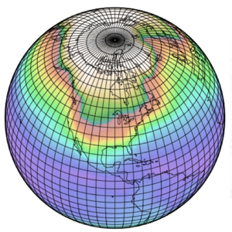
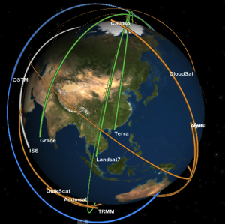
Bridging Models and Observations
Global Models
Systematic IT Support & Infrastructure
Systematic coordination of obs for MIPs
Global Modeling
Observations
Systematic Model
Development & Improvement
Closing Gap
AMIP I&II
ESGF
xMIPs
obs4MIPs
CMIP 1&2
CMIP 3&5
Clim Metrics Panel
Systematic Model
Experiments
Systematic Application of Metrics
2+ Decades of Directed Progress
Notes:
Heavy emphasis and acknowledgement given to speaker - *Stephens :)

Slide 7
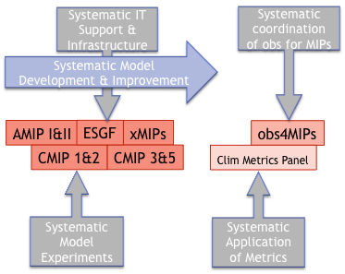

Bridging Models and Observations
Regional Models
Regional Modeling
Observations
GCM heritage
can be utilized
Ensembles
& NARCCAP
ESGF
< Bigger Model-Obs Gap >
CORDEX
RCMES
Systematic Model
Experiments
Notes:
Heavy emphasis and acknowledgement given to speaker - *Stephens :)

Slide 8
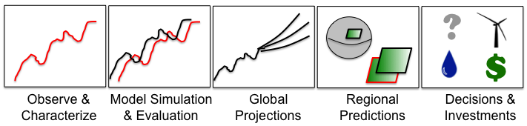
RCMES Motivation & Goals
GOALS
RCMES
  Make observation datasets, with some emphasis on satellite data, more accessible to the RCM community.
  Make the evaluation process for regional climate models simpler, quicker and physically more comprehensive.
  Provide researchers more time to spend on analysing results and less time coding and worrying about file formats, data transfers, etc.
BENEFITS
    Quantify model strengths/weaknesses for development/improvement efforts
    Improved understanding of uncertainties in predictions

Slide 9
RCMES Motivation & Goals
RCMES v2.0 – High-Level Architecture
Other Data Centers
(ESG, DAAC, ExArch Network)
User
input
Model data
URL
TRMM
Metadata
Extract OBS data
Extract model data
MODIS
Data Table
Regridder
(Put the OBS & model data on the same time/space grid)
Data Table
Use the re-gridded data for user’s own analyses and VIS.
AIRS
Extractor for various data formats
MySQL
Data Table
Data extractor
(Binary or netCDF)
CERES
Data Table
Metrics Calculator
(Calculate evaluation metrics)
Soil moisture
Data Table
Data Table
Common Format,
Native grid,
Efficient architecture
Visualizer
(Plot the metrics)
ETC
Raw Data:
Various sources, formats,
Resolutions,
Coverage
RCMED
(Regional Climate Model Evaluation Database)
A large scalable database to store data from variety of sources in a common format
RCMET
(Regional Climate Model Evaluation Tool)
A library of codes for extracting data from RCMED and model and for calculating evaluation metrics
Ingest obs/models, re-grid, calculate metrics (e.g, bias, RMSE, correlation, significance, PDFs), and visualize results (e.g., contour, time series, Taylor).
RCMES
High-level technical architecture
RCMES
High-level technical architecture
user
choice
RCM data
user
choice
RCM data
URL
TRMM
Metadata
URL
Extract OBS data
Extract RCM data
TRMM
Metadata
Extract OBS data
Extract RCM data
Data Table
User’s own codes for ANAL and VIS.
MODIS
Data Table
User’s own codes for ANAL and VIS.
MODIS
Data Table
Regridder
Put the OBS & RCM data on the same grid for comparison
Data Table
Regridder
Put the OBS & RCM data on the same grid for comparison
AIRS
Extractor
MySQL
AIRS
Extractor
MySQL
Data Table
Data extractor
(Fortran binary)
Data Table
Data extractor
(Fortran binary)
SWE
Data Table
Metrics Calculator
Calculate comparison metrics
SWE
Data Table
Metrics Calculator
Calculate comparison metrics
Soil moisture
Data Table
Data extractor
(Fortran binary)
Soil moisture
Data Table
Data extractor
(Fortran binary)
Data Table
Data Table
Visualizer
Plot the metrics
ETC
Common Format,
Native grid,
Efficient architecture
Visualizer
Plot the metrics
ETC
Common Format,
Native grid,
Efficient architecture
Raw Data:
Various Formats,
Resolutions,
Coverage
RCMED
(Regional Climate Model Evaluation Database)
A large scalable database to store data in a common format
RCMET
(Regional Climate Model Evaluation Toolkit)
A library of codes for extracting data from RCMED and model and for calculating evaluation metrics
Raw Data:
Various Formats,
Resolutions,
Coverage
RCMED
(Regional Climate Model Evaluation Database)
A large scalable database to store data in a common format
RCMET
(Regional Climate Model Evaluation Toolkit)
A library of codes for extracting data from RCMED and model and for calculating evaluation metrics

Slide 10
RCMES Observations and Analysis Tools
AVAILABLE
Satellite retrievals: AIRS gridded daily 3D temperature and water vapor; MODIS daily Cloud fraction and snow cover; CERES surface & TOA radiation; Snow Water Equivalent (SWE) data (Sierra Nevada); AMSR-E SST, QuikSCAT winds; AVISO sea-level height
Satellite-based precipitation data: TRMM 3B42 precipitation (0.25deg); GPCP 2.5deg
Reanalysis data: MERRA (Sea level, Surface pressure); ERA-Interim (surface temperature, dewpoint, & precipitation; 3D temperature & geopotential); NLDAS (a number of hydrology related variables)
Gridded surface station analyses: University of Delaware and CRU precipitation & temperature (0.5deg); APHRODITE Monsoon Asia precipitation (0.25deg); NCEP/CPC Unified Rain gauge Data (0.25deg)
Gridded surface atmosphere and land fields: GSFC NLDAS
FUTURE
CloudSat atmospheric ice and liquid, Satellite-based snow (Himalayas), ISCCP cloud fraction, MERRA (water vapor, surface and pressure-level variables), Fine-scale SST, More APHRODITE regions (Eurasia), etc.
  Evaluation metrics: Bias, RMSE, correlations, PDFs, Bivariate PDFs, etc.
  Visualization: Contour maps, Taylor & Portrait diagrams, time series, etc.
RCMES
High-level technical architecture
RCMES
High-level technical architecture
user
choice
RCM data
user
choice
RCM data
URL
TRMM
Metadata
URL
Extract OBS data
Extract RCM data
TRMM
Metadata
Extract OBS data
Extract RCM data
Data Table
User’s own codes for ANAL and VIS.
MODIS
Data Table
User’s own codes for ANAL and VIS.
MODIS
Data Table
Regridder
Put the OBS & RCM data on the same grid for comparison
Data Table
Regridder
Put the OBS & RCM data on the same grid for comparison
AIRS
Extractor
MySQL
AIRS
Extractor
MySQL
Data Table
Data extractor
(Fortran binary)
Data Table
Data extractor
(Fortran binary)
SWE
Data Table
Metrics Calculator
Calculate comparison metrics
SWE
Data Table
Metrics Calculator
Calculate comparison metrics
Soil moisture
Data Table
Data extractor
(Fortran binary)
Soil moisture
Data Table
Data extractor
(Fortran binary)
Data Table
Data Table
Visualizer
Plot the metrics
ETC
Common Format,
Native grid,
Efficient architecture
Visualizer
Plot the metrics
ETC
Common Format,
Native grid,
Efficient architecture
Raw Data:
Various Formats,
Resolutions,
Coverage
RCMED
(Regional Climate Model Evaluation Database)
A large scalable database to store data in a common format
RCMET
(Regional Climate Model Evaluation Toolkit)
A library of codes for extracting data from RCMED and model and for calculating evaluation metrics
Raw Data:
Various Formats,
Resolutions,
Coverage
RCMED
(Regional Climate Model Evaluation Database)
A large scalable database to store data in a common format
RCMET
(Regional Climate Model Evaluation Toolkit)
A library of codes for extracting data from RCMED and model and for calculating evaluation metrics
Notes:
JK: add ERA-Interim precipitation, all precipitation data are monthly for now, GEWEX-SRB (SW and LW fluxes at the surface and TOA), TRMM (0.25deg)

Slide 11
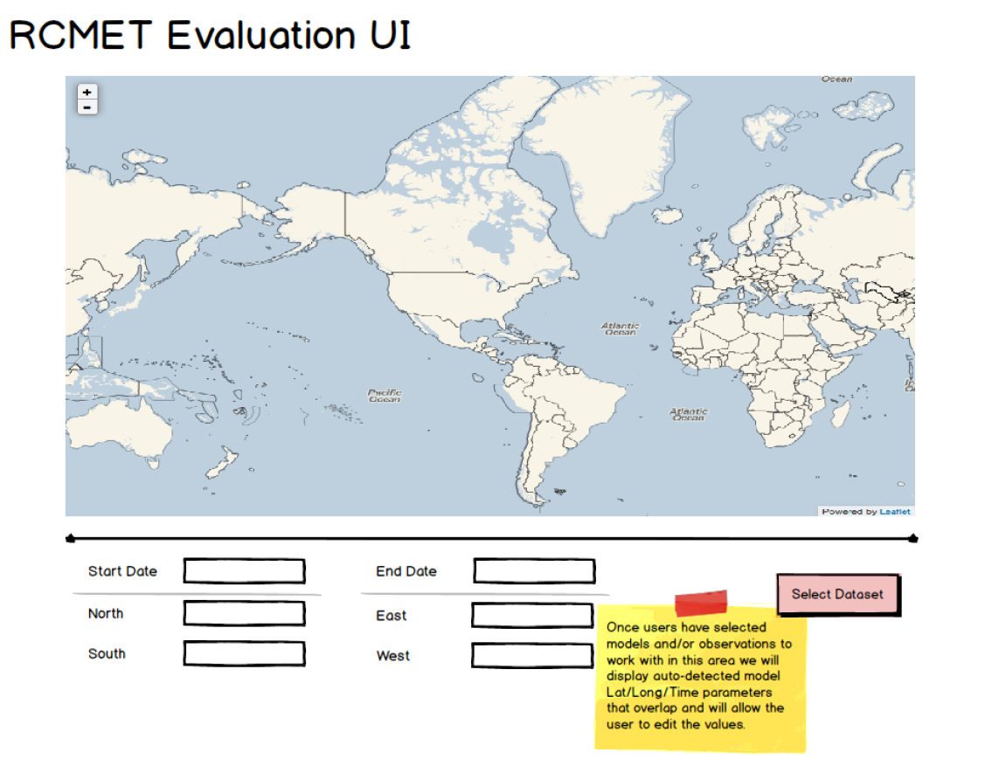
3 Ways to Use RCMES
Easy: Graphical user interface (UI) version.
  Point and click model evaluation.
  See demo video at rcmes.jpl.nasa.gov/training/videos.
  Runs in a virtual machine (VM) environment.
Intermediate: Command line version (also in VM)
Advanced: Check out open source code at: climate.incubator.apache.org.
  Requires installation of Python libraries on user’s machine.
  Allows users to contribute to RCMES development
* All downloads are available at rcmes.jpl.nasa.gov *
RCMES User Interface

Slide 12
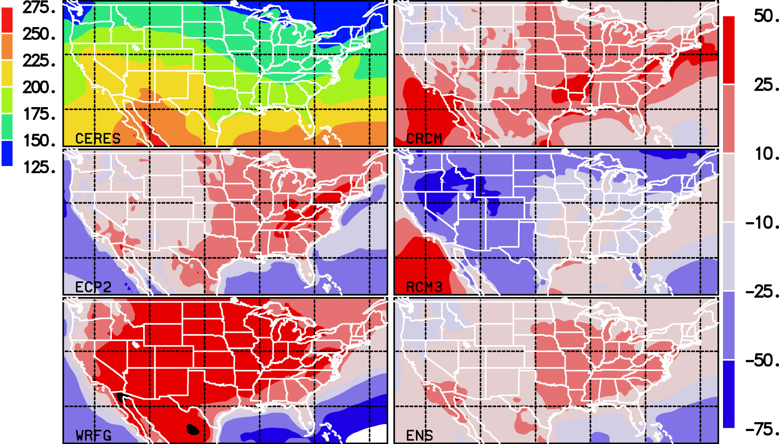
Example: Surface Energy Budget – Shortwave Radiation
NARCCAP RCM biases in surface insolation against GEWEX-SRB
Wm⁻²
Kim, J., D.E. Waliser, C.A. Mattmann, L.O. Mearns, C.E. Goodale, A.F. Hart, D.J. Crichton, and S. McGinnis, 2013: J. Climate.

Slide 13
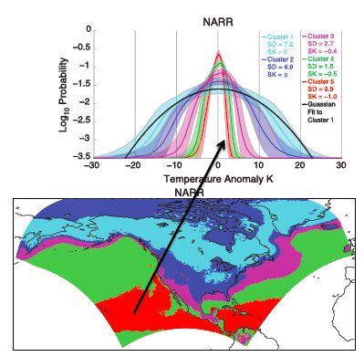
Development : PDFs and Quantifying Extremes
  K-means clustering used to group the January surface temperature PDFs into 5 categories.
  Cluster assignments
    The red curve is the average of all PDFs shaded in red on map, etc.
    Clusters primarily reflect variance, with some skewness
  Cluster analysis can provide a basis for identifying regions of common PDF morphology
  Loikith et al., 2013, Geophys. Res. Lett., 40, 3710-3714.

Slide 14
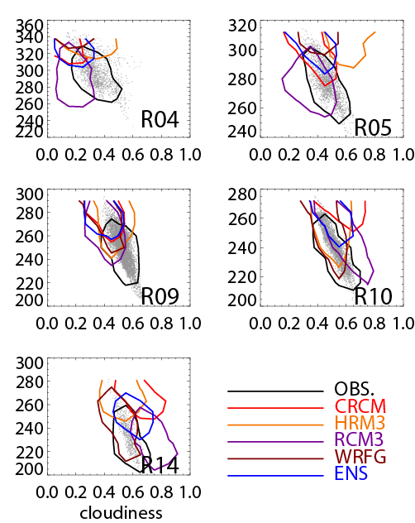
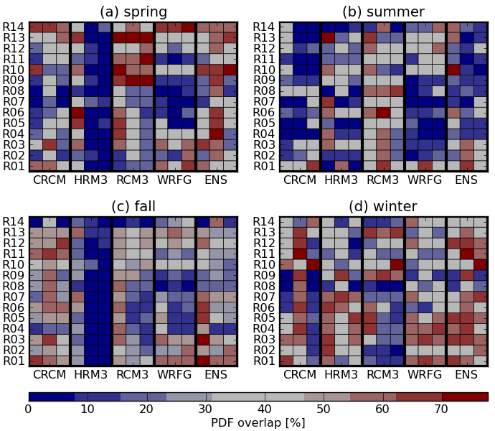
Development : PDFs and Quantifying Extremes
  Bivariate PDF skill score
    Measure models’ skill in simulating related variables.
    The example evaluates the cloudiness-surface insolation relationship in the NARCCAP hindcast.
    Results can be visualized using a portrait diagram.
  Lee et al., 2013, J. Geophys. Res., submitted.

Slide 15
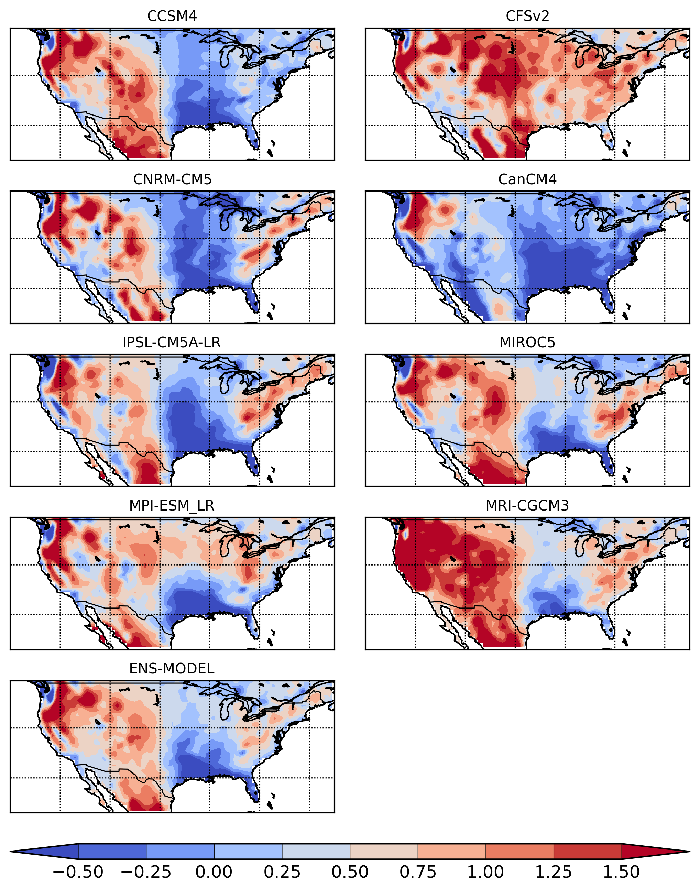
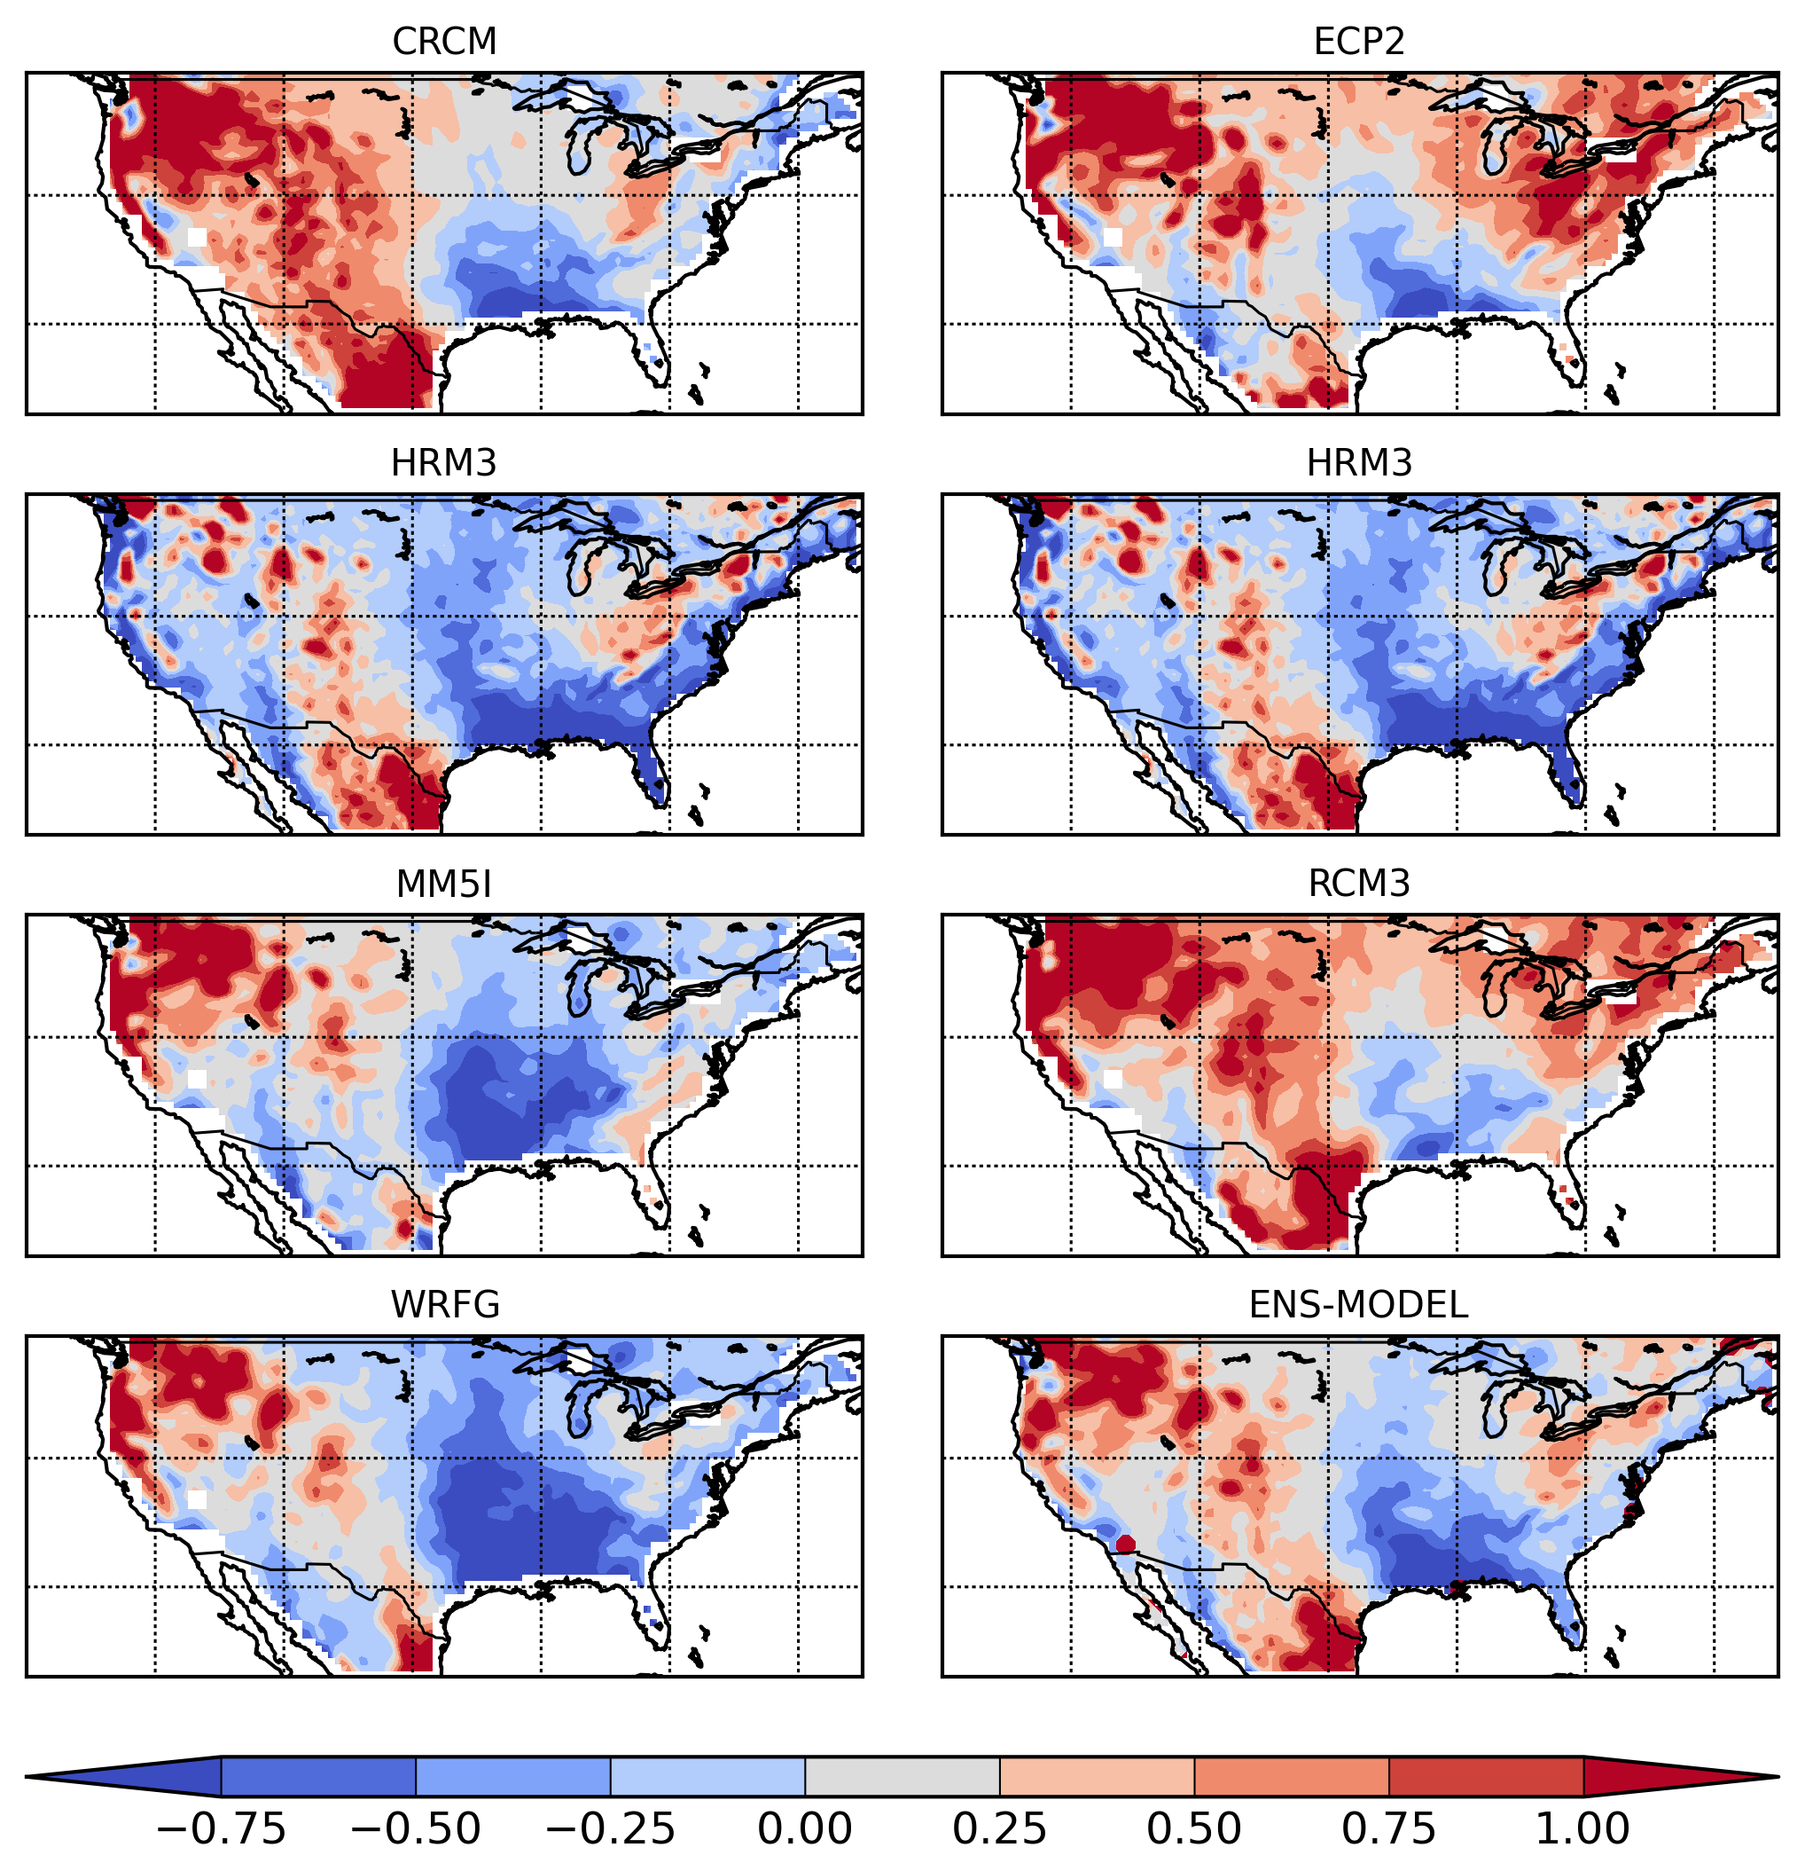
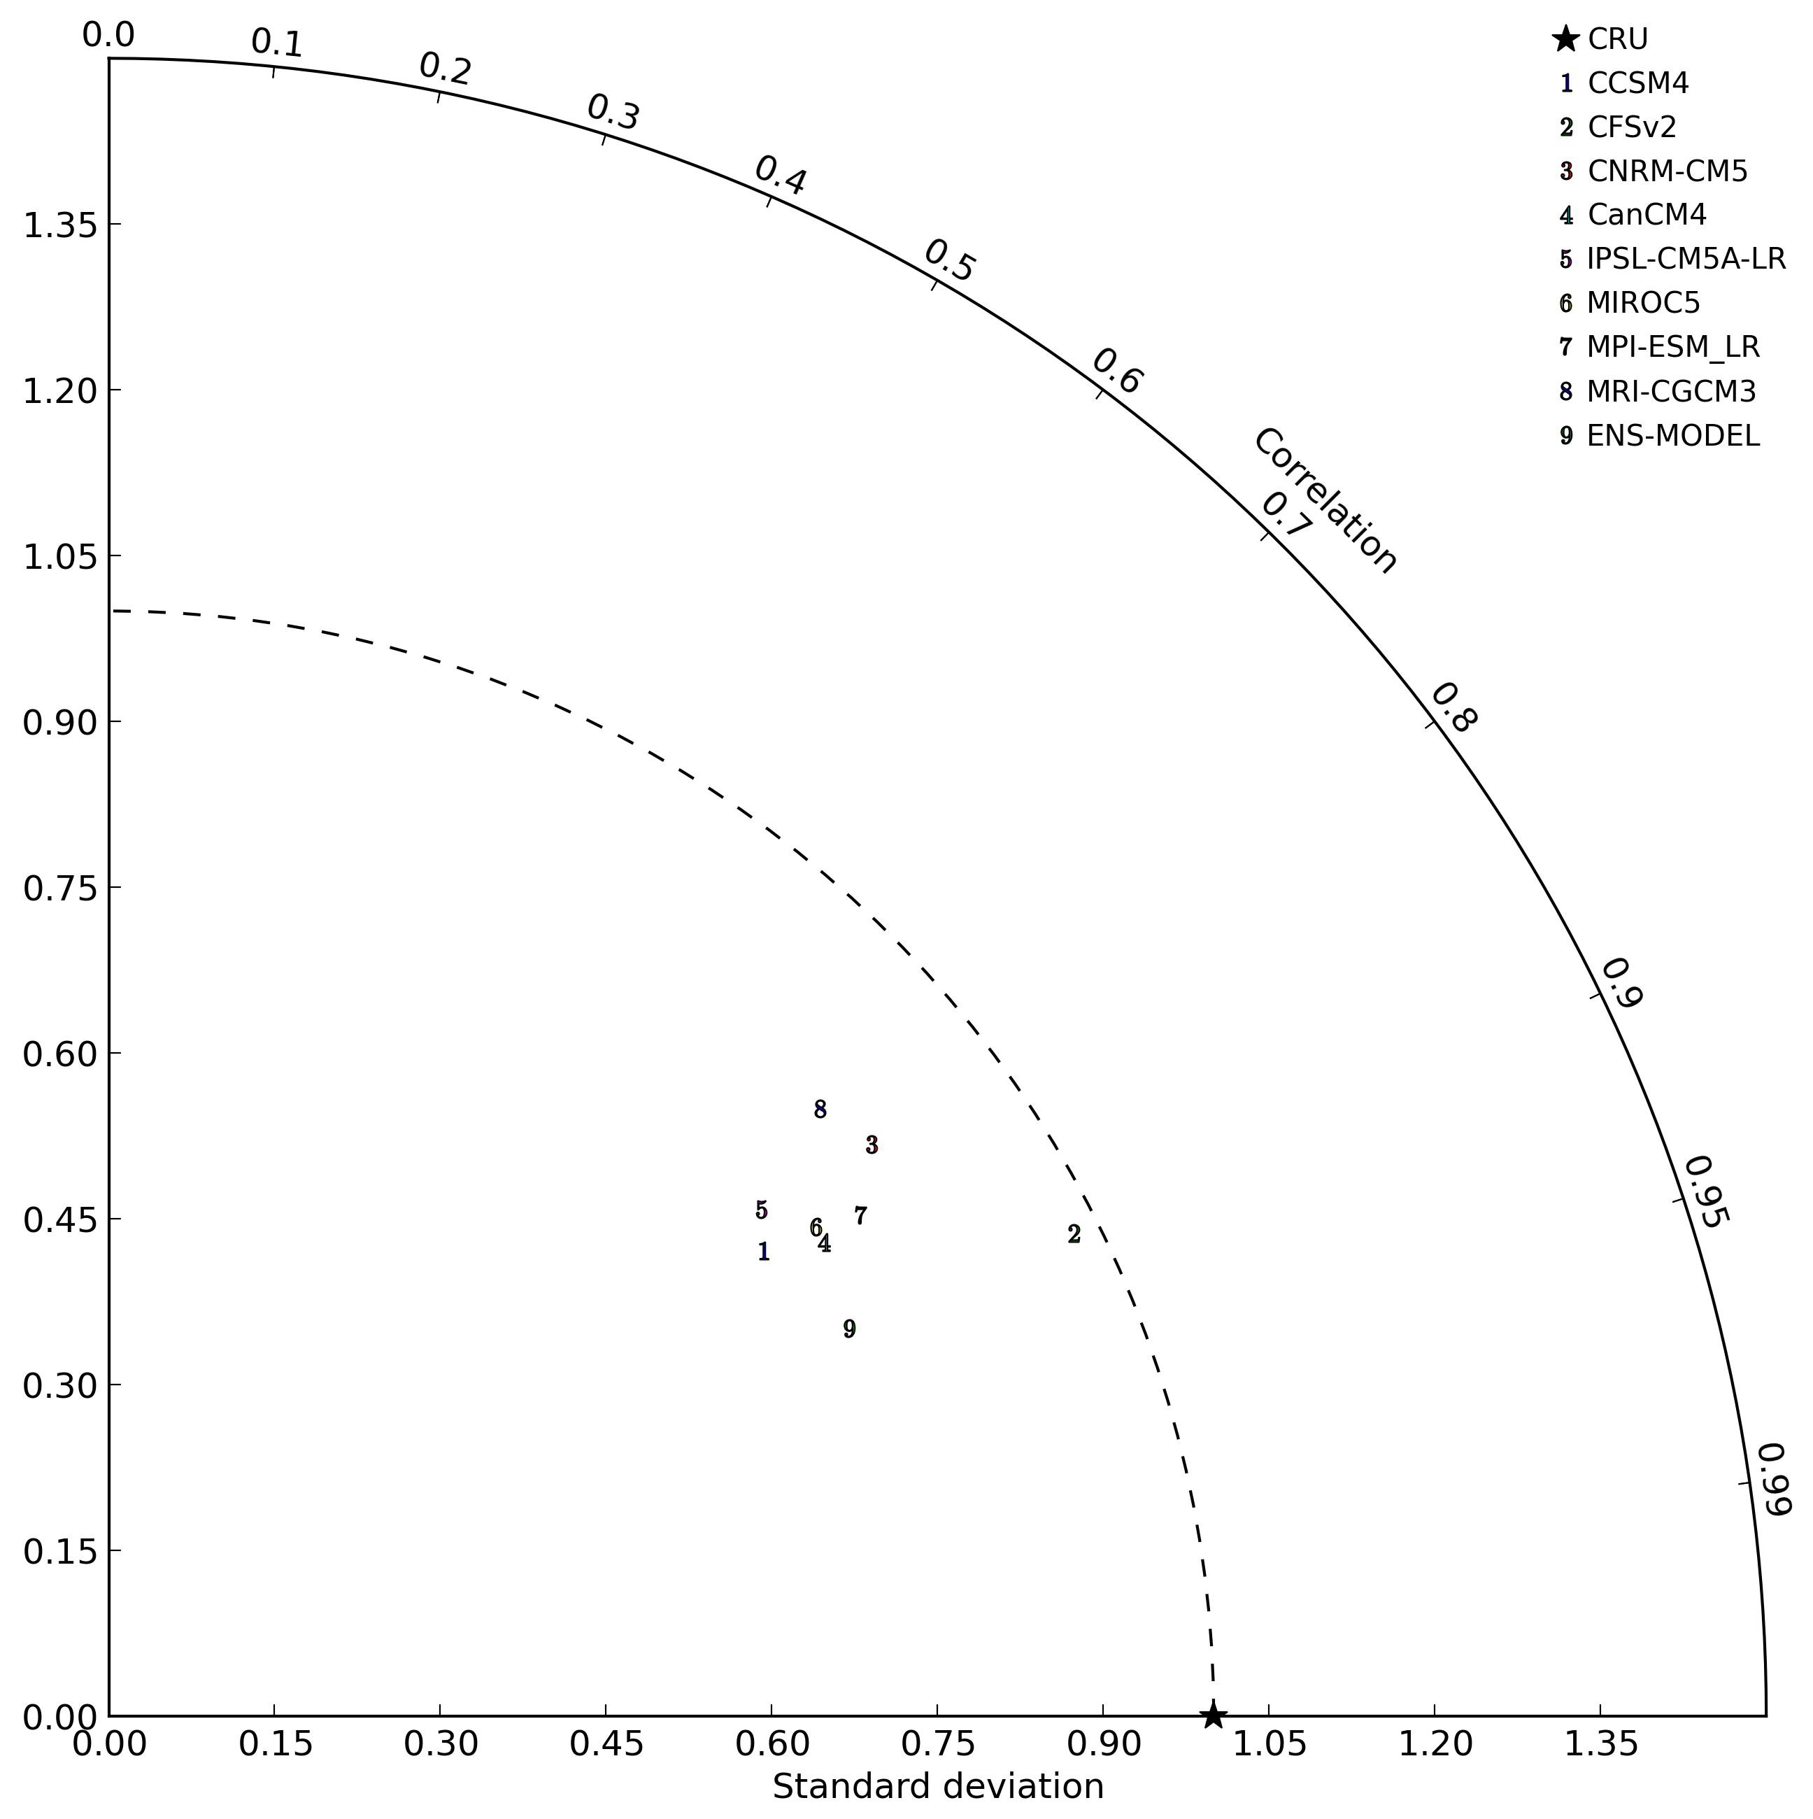
Capability to Perform Regional Evaluation of GCMs
Annual Precipitation Bias
CMIP5 GCMs - observation
NARCCAP RCMs - observation
Courtesy: Huikyo Lee
NARCCAP
Direct Access to ESGF in Progress
CMIP
Notes:
# Figure: July precipitation bias between ensemble of three observations (CRU 3.1, UDEL and GPCP) [left: and ensemble of eight CMIP5 GCMs, right: and ensemble of four NARCCAP RCMs]
# Biases in NARCCAP RCMs are smaller than those in the GCMs. Especially, GCMs show the large precipitation bias in southern Texas.

Slide 16
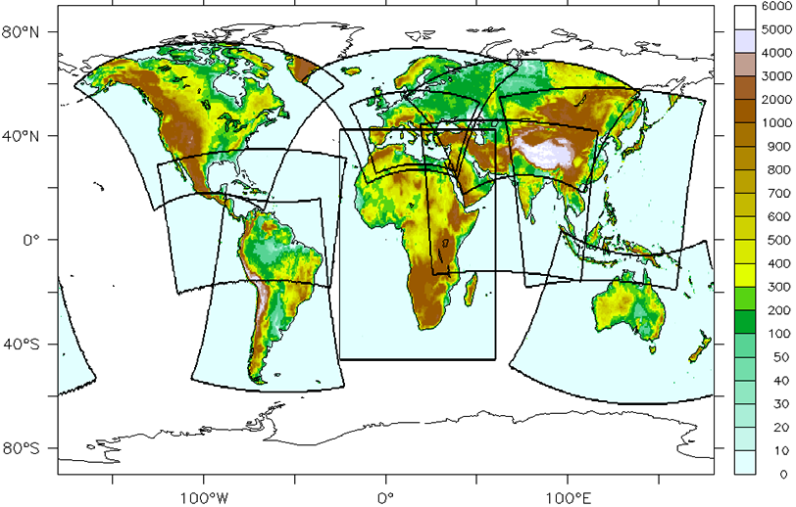
CORDEX Interactions & Support
N. America –NARCCAP via NCAR/Mearns for U.S. NCA
Africa – collaboration with UCT/Hewitson & Rossby Ctr/Jones
E. Asia – exploring collaboration with KMA & APCC, particip. in Sep’11 & Nov’12 mtgs
S. Asia – collaboration with IITM/Sanjay, participated Oct’12 & Sep’13 mtgs.
Arctic – participated in initial Mar’12 mtg and possibly Friday mtg
Caribbean, S. America –participated in 1st major mtg Sep’13
Middle East – N. Africa –participating in initial coordinating team and Friday’s mtg
Typically try to support meetings by sending a climate scientist and an IT expert, provide an overview and a tutorial/training.
Have hosted scientists & students at JPL/UCLA
Learning RCM User Needs
Infusing Support into
CORDEX

Slide 17


RCMES article in the Oct 2012 issue of the WMO Bulletin highlighting its potential role in WMO’s new Global Framework for Climate Services
Kim Whitehall is a Howard University graduate student. She spent the summer at JPL learning & contributing to RCMES.

Slide 18



Summary
Systematic model evaluation needs continued growth and high priority within CORDEX. “Performance Metrics” (good or bad) not enough – “Process-oriented diagnostics” (why?) needed.
Steadfast model development and improvement across the community needs to be a more prolific part of CORDEX.
An RCM evaluation system (RCMES) has been developed to support RCM/CORDEX model evaluation and improvement.
RCMES provides single point access to wide range of global and regional observation data sets, with some emphasis on satellite data sets.
RCMES provides basis analysis and visualization tools.
RCMES will have full function access to ESGF (CMIP or CORDEX) soon.
RCMES database and tools are extensible – an intrinsic capability in some areas and via an open source code approach.
RCMES easy (web/slow), intermediate (virtual machine), and expert (open source) access.
There is a long way to go and many things RCMES could/should do but doesn’t (yet). Your input and participation is welcome.
We welcome interactions with CORDEX domain activities and individuals.

Slide 19

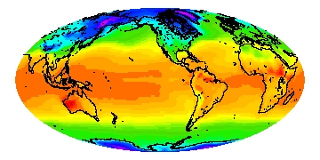
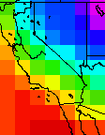
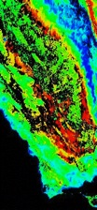
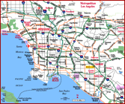
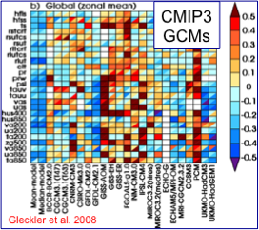
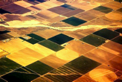
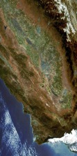
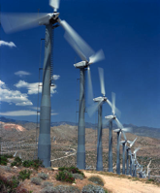

RCMES Overview
Global Climate
Projections
Regional
Downscaling
Decision
Support
RCMES provides observations & IT tools to carry out regional climate model evaluations and in turn support quantitative climate assessment activities and inform decision support agencies.

