Slide 1


The Regional Climate Model Evaluation System (RCMES): A Training Session
Jet Propulsion Laboratory
California Institute of Technology
Paul C. Loikith, Paul Ramirez, Huikyo Lee, and the RCMES Climate and Computer Science Teams
3rd Lund Regional-scale Climate Modeling Workshop
Lund, Sweden
June 18, 2014
rcmes.jpl.nasa.gov climate.apache.org

Slide 2
Today’s Agenda
8-8:45: Welcome and introduction to RCMES
8:45-9:15: RCMES demo and installation
9:15-10:00: Activity #1: Evaluation with CORDEX Africa data
10:00-10:15: Break
10:15-10:30: Introduction to Activity #2: How to customize scripts
10:30-11:00: Activity #2: Evaluation with EURO CORDEX
11:00-11:15: Other ways to use RCMES
11:15-12:00: Introduction to the Apache Open Climate Workbench: What powers RCMES and how to get involved with development.

Slide 3
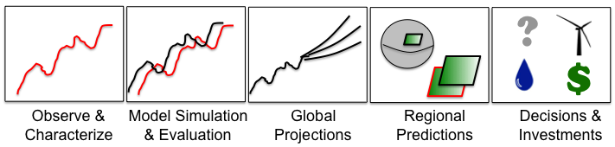
RCMES Motivation & Goals
GOALS
RCMES
  Make observation datasets, with some emphasis on satellite data, more accessible to the RCM community.
  Make the evaluation process for regional climate models simpler, quicker and physically more comprehensive.
  Provide researchers more time to spend on analysing results and less time coding and worrying about file formats, data transfers, etc.
BENEFITS
    Quantify model strengths/weaknesses for development/improvement efforts
    Improved understanding of uncertainties in predictions

Slide 4
The Regional Climate Model Evaluation System (RCMES)
Joint collaboration: JPL/NASA, UCLA
Two main components
  Database of observations
  Evaluation Toolkit
Python-based open source software powered by the Apache Open Climate Workbench

Slide 5
Meet the RCMES Team
Climate Science Team:
Duane Waliser (PI, JPL/Caltech, UCLA), Paul Loikith (JPL/Caltech), Huikyo Lee (JPL/Caltech), Jinwon Kim (UCLA), Kim Whitehall (Howard University),
Danielle Groenen (Florida State University)
Computer Science/Development Team:
Chris Mattmann (PI, JPL/Caltech, UCLA), Paul Ramirez (JPL/Caltech),
Cameron Goodale (JPL/Caltech), Michael Joyce (JPL/Caltech),
Maziyar Boustani (JPL/Caltech), Andrew Hart (JPL/Caltech),
Shakeh Khudikyan (JPL/Caltech),
Jesslyn Whittel (University of California, Berkeley),
Alex Goodman (Colorado State University)
rcmes.jpl.nasa.gov

Slide 6
Regional Climate Model Evaluation System
High-Level Architecture
Other Data Centers
(ESG, DAAC, ExArch Network)
User
input
Model data
URL
TRMM
Metadata
Extract OBS data
Extract model data
MODIS
Data Table
Regridder
(Put the OBS & model data on the same time/space grid)
Extractor for various data formats
Data Table
Use the re-gridded data for user’s own analyses and VIS.
AIRS
Data Table
PostgreSQL
Data extractor
(Binary or netCDF)
CERES
Data Table
Metrics Calculator
(Calculate evaluation metrics)
Soil moisture
Data Table
Data Table
Common Format,
Native grid,
Efficient architecture
Visualizer
(Plot the metrics)
ETC
Raw Data:
Various sources, formats,
Resolutions,
Coverage
RCMED
(Regional Climate Model Evaluation Database)
A large scalable database to store data from variety of sources in a common format
RCMET
(Regional Climate Model Evaluation Toolkit)
A library of codes for extracting data from RCMED and model and for calculating evaluation metrics
RCMES
High-level technical architecture
RCMES
High-level technical architecture
user
choice
RCM data
user
choice
RCM data
URL
TRMM
Metadata
URL
Extract OBS data
Extract RCM data
TRMM
Metadata
Extract OBS data
Extract RCM data
Data Table
User’s own codes for ANAL and VIS.
MODIS
Data Table
User’s own codes for ANAL and VIS.
MODIS
Data Table
Regridder
Put the OBS & RCM data on the same grid for comparison
Data Table
Regridder
Put the OBS & RCM data on the same grid for comparison
AIRS
Extractor
MySQL
AIRS
Extractor
MySQL
Data Table
Data extractor
(Fortran binary)
Data Table
Data extractor
(Fortran binary)
SWE
Data Table
Metrics Calculator
Calculate comparison metrics
SWE
Data Table
Metrics Calculator
Calculate comparison metrics
Soil moisture
Data Table
Data extractor
(Fortran binary)
Soil moisture
Data Table
Data extractor
(Fortran binary)
Data Table
Data Table
Visualizer
Plot the metrics
ETC
Common Format,
Native grid,
Efficient architecture
Visualizer
Plot the metrics
ETC
Common Format,
Native grid,
Efficient architecture
Raw Data:
Various Formats,
Resolutions,
Coverage
RCMED
(Regional Climate Model Evaluation Database)
A large scalable database to store data in a common format
RCMET
(Regional Climate Model Evaluation Toolkit)
A library of codes for extracting data from RCMED and model and for calculating evaluation metrics
Raw Data:
Various Formats,
Resolutions,
Coverage
RCMED
(Regional Climate Model Evaluation Database)
A large scalable database to store data in a common format
RCMET
(Regional Climate Model Evaluation Toolkit)
A library of codes for extracting data from RCMED and model and for calculating evaluation metrics

Slide 7
Regional Climate Model Evaluation Database (RCMED)
Remote Sensing, In Situ, Reanalysis
Temperature (AIRS, CRU, UDEL)
Precipitation (TRMM, CRU, UDEL, CPC, GPCP)
Radiation/clouds (CERES, MODIS)
Sea surface height (AVISO)
Sea surface temperature (AMSRE)
Winds (QuikSCAT)
Multivariate reanalysis (MERRA, NARR, NLDAS, ERA-Interim)
Snow Water Equivalent (SNODAS)
Evapotranspiration (RHEAS)
More to come…

Slide 8

Evaluation of Cloud Computing for Storage & Application of NASA Observations
Challenge
  Regional climate model evaluation with daily temporal resolution to assess representation of extreme events.
  More voluminous, requires scalability in web services, system throughput, and also elasticity based on study demands
Objective
  Understand and evaluate popular cloud computing technologies, and provide a framework for selecting the best one for supporting Regional Climate Model Evaluation System (RCMES) & applications such as the National Climate Assessment and IPCC’s CORDEX regional model evaluations.
Results
  Conducted evaluation demonstrating 44 %
  avg query time speedup of PostGIS over MySQL
  for 5 years of 5 parameters of obs data in RCMES
  Will incorporate into RCMES to facilitate NCA
  and CORDEX regional model evaluations.
C. Mattmann, D. Waliser, J. Kim, C. Goodale, A. Hart, P. Ramirez, D. Crichton, P. Zimdars, M. Boustani, H. Lee, P. Loikith, K. Whitehall, C. Jack, B. Hewitson. Cloud Computing and Virtualization Within the Regional Climate Model and Evaluation System. Earth Science Informatics, 2013.

Slide 9
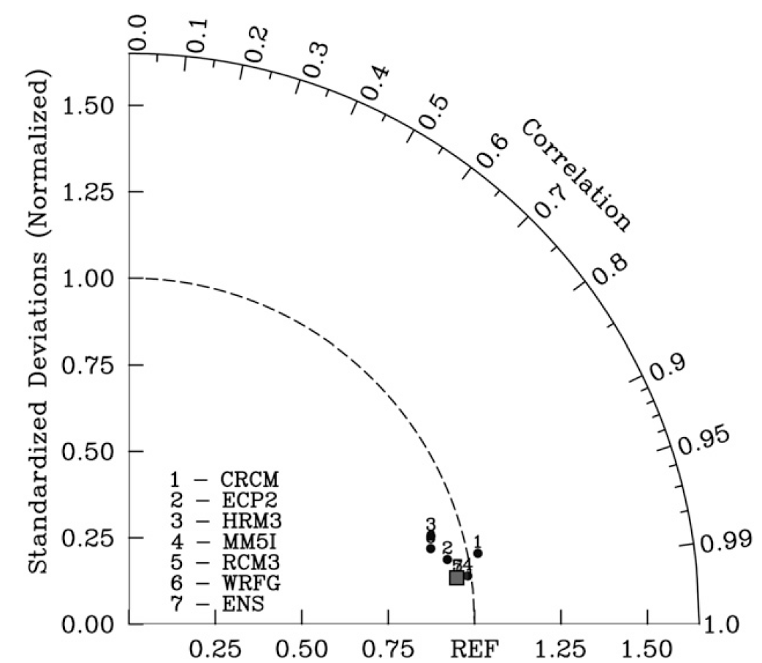
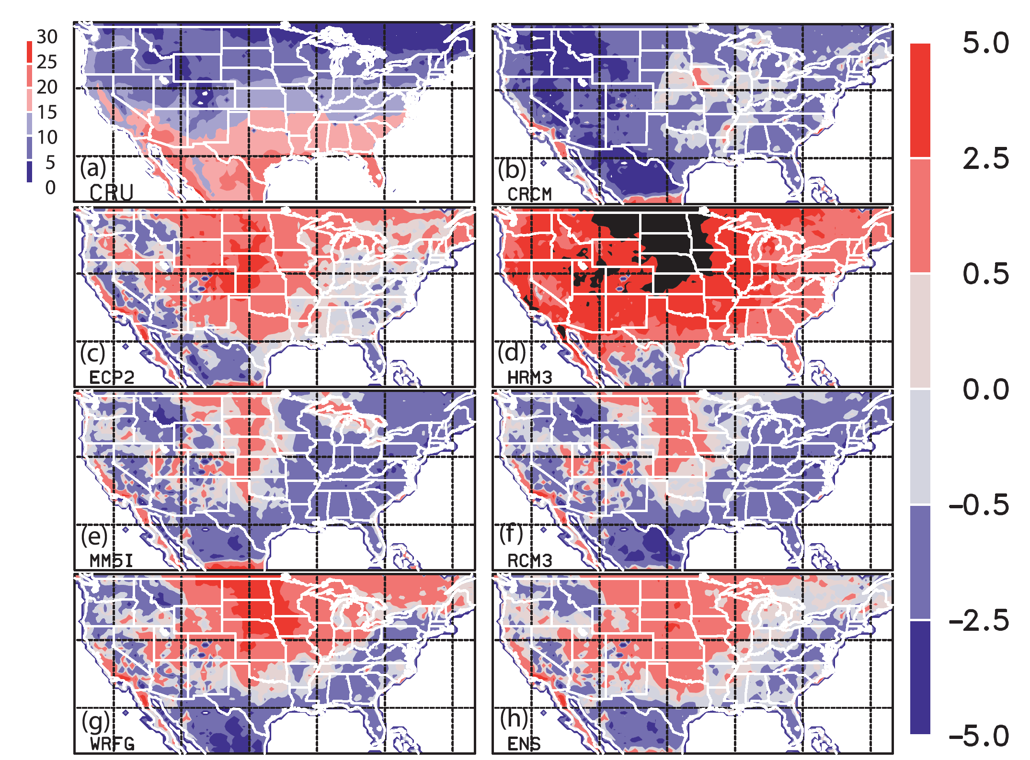
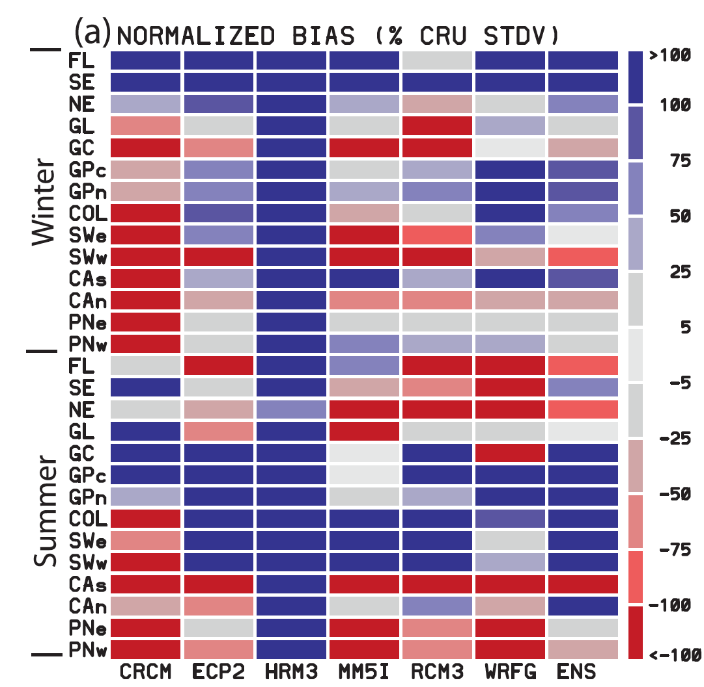
Regional Climate Model Evaluation Toolkit (RCMET)
Interpolates observations and models to common grid
  User defined
  Bi-linear, scipy.interpolate.griddata
Computes and visualizes commonly used metrics (bias, Taylor Diagrams, etc.)
RCMET is built as a Python library with a growing number of useful functions to facilitate model evaluation.
Bias Maps
Portrait Diagrams
Taylor Diagrams
Kim, J., D. E. Waliser, C. A. Mattmann, L. O. Mearns, C. E. Goodale, A. F. Hart, D. J. Crichton, S. McGinnis, H. Lee, P. C. Loikith, and M. Boustani, 2013: Evaluation of the Surface Air Temperature, Precipitation, and Insolation over the Conterminous U.S. in the NARCCAP Multi-RCM Hindcast Experiment Using RCMES, J. Climate, 26, 5698-5715.

Slide 10
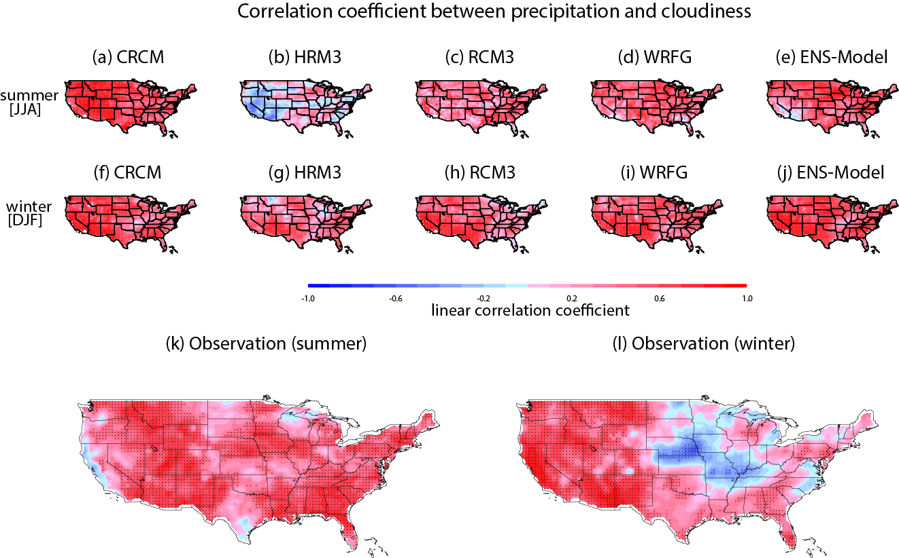
NARCCAP Cloud-precipitation-radiation relationship
Poor agreement for HRM3
Lee, H., J. Kim, D. E. Waliser, P. C. Loikith, C. A. Mattmann, and S. McGinnis, Evaluation of simulation fidelity for precipitation, cloud fraction and insolation in the North America Regional Climate Change Assessment Program (NARCCAP), in review for Climate Dynamics.
rcmes.jpl.nasa.gov

Slide 11
Evaluation of NARCCAP Temperature PDFs and Extremes
Skewness=-1
Most models reproduce boundary between primarily positive and negative skewness well
Skewness is primarily positive in north where large warm temperature excursions occur due to infrequent warm advection from south, these are not possible on cold tail
Coherent area of negative skewness from Pacific Ocean to Great Lakes is well simulated
Observational uncertainty low-NARR and MERRA agree well
Surface temperature skewness
Loikith, P. C., D. E. Waliser, J. Kim, H. Lee, B. R. Lintner, J. D. Neelin, S. McGinnis, C. Mattmann, and L. O. Mearns, Surface Temperature Probability Distributions in the NARCCAP Hindcast Experiment: Evaluation Methodology, Metrics and Results, under review for J. Climate.
rcmes.jpl.nasa.gov

Slide 12
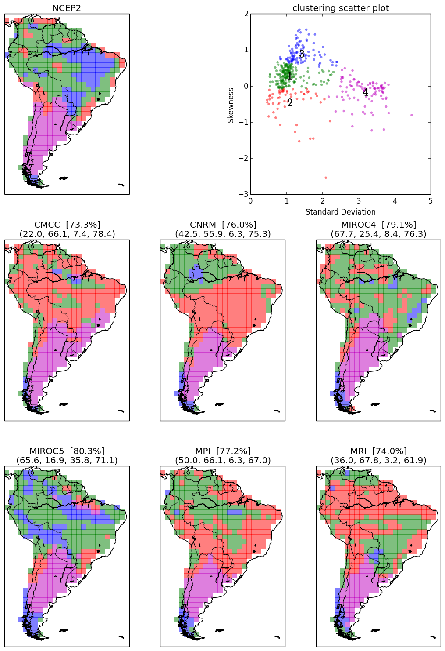
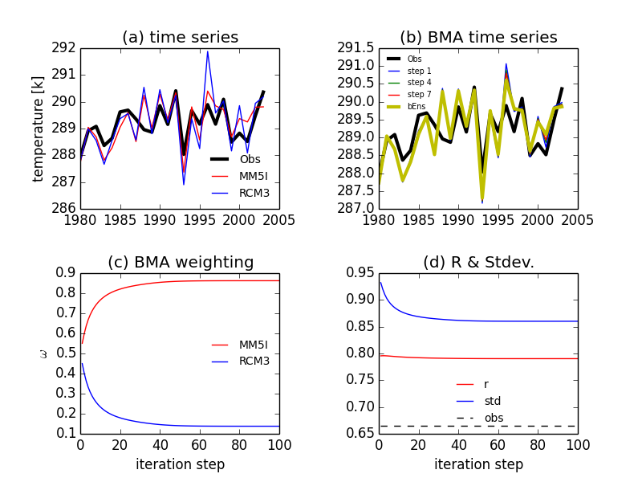
Ongoing Model Evaluation Studies
Not just for RCMs, CMIP data too!
Bayesian model averaging for optimal multi-model ensemble configurations.
(Huikyo Lee - lead)
Large scale meteorological patterns associated with temperature extremes over North America (Paul Loikith - lead )
K-means clustering to evaluate surface temperature variance and skewness over South America (Huikyo Lee - lead).

Slide 13
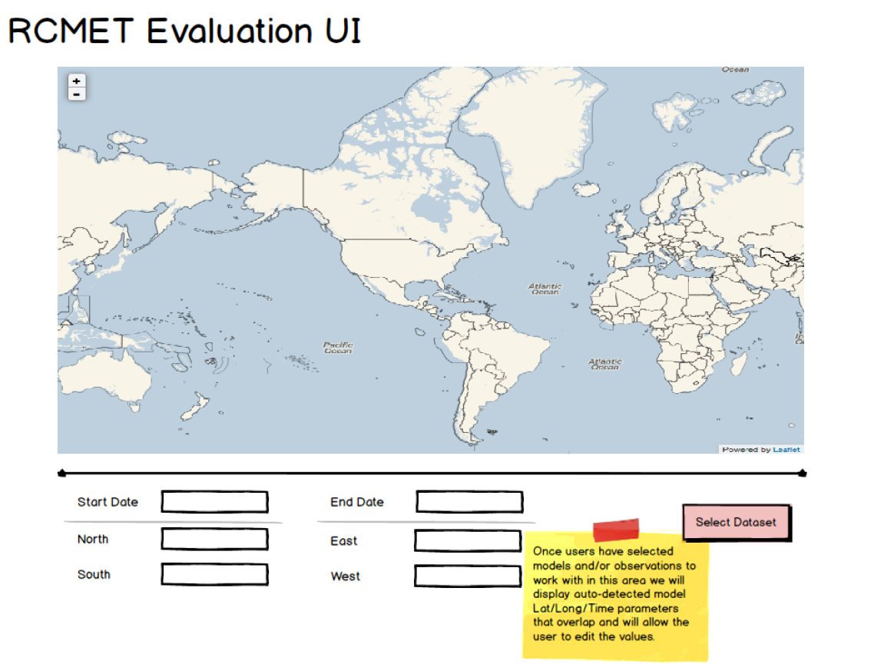
Ways to Use RCMES
RCMES in a virtual machine environment
  Downloadable from rcmes.jpl.nasa.gov/downloads
  Comes with all Python libraries and dependencies installed
RCMES on Mac or Linux machine
  Source code downloadable from http://climate.incubator.apache.org/
  Requires all necessary Python libraries installed on local machine
Can interact programmatically or with a point and click user interface.

Slide 14
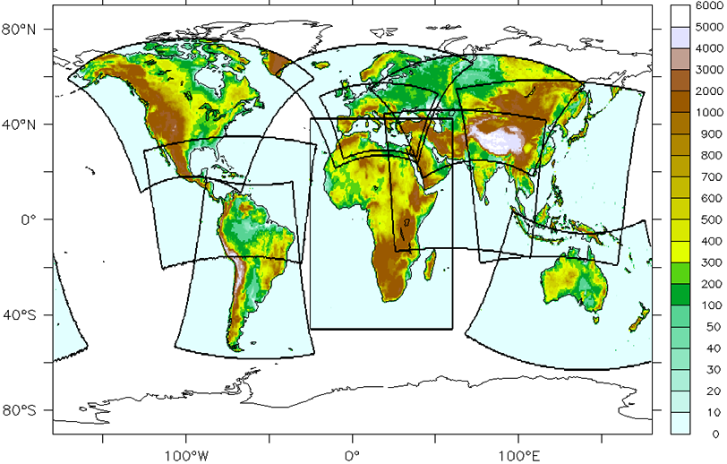
CORDEX Interactions & Support
N. America –NARCCAP via NCAR/Mearns for U.S. NCA
Africa – collaboration with UCT/Hewitson & Rossby Ctr/Jones
E. Asia – exploring collaboration with KMA & APCC, particip. in Sep’11 & Nov’12 mtgs
S. Asia – collaboration with IITM/Sanjay, participated Oct’12 & Sep’13 mtgs.
Arctic – participated in initial Mar’12 mtg and Nov’13 and Jun’14
Caribbean, S. America –participated in 1st major mtg Sep’13 and 2nd Apr’14
Middle East – N. Africa –participating in initial coordinating team and Friday’s mtg
Typically try to support meetings by sending a climate scientist and an IT expert, provide an overview and a tutorial/training.
Have hosted scientists & students at JPL/UCLA
Learning RCM User Needs
Infusing Support into
CORDEX

Slide 15
Future Direction
Development is ongoing…
  Expansion of database
  Adding more metrics to RCMET
  Growing user and developer base
Connection to ESGF
Improving user experience

Slide 16
Where to find more information:
rcmes.jpl.nasa.gov
http://climate.apache.org/
Email team members or dev@climate.apache.org
Contacts:
Paul Loikith: paul.c.loikith@jpl.nasa.gov
Kyo Lee: huikyo.lee@jpl.nasa.gov
Paul Ramirez: paul.m.ramirez@jpl.nasa.gov

Slide 17
Does everyone have RCMES working in Virtual Box?
https://www.virtualbox.org/wiki/Downloads
Move on to activity #1…

