Slide 1
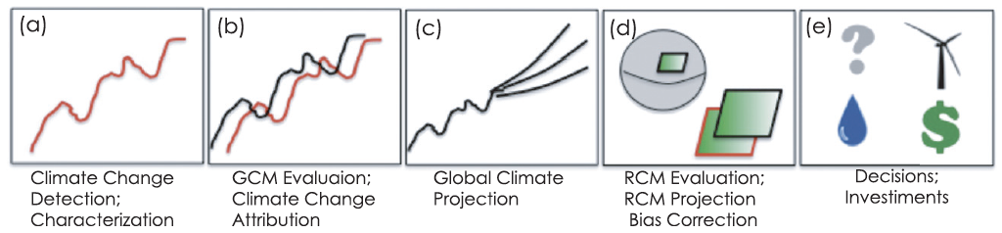

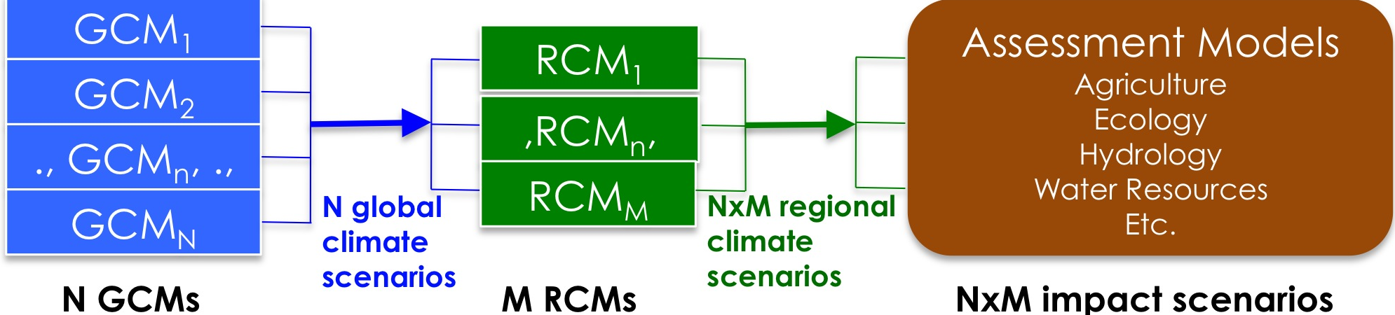
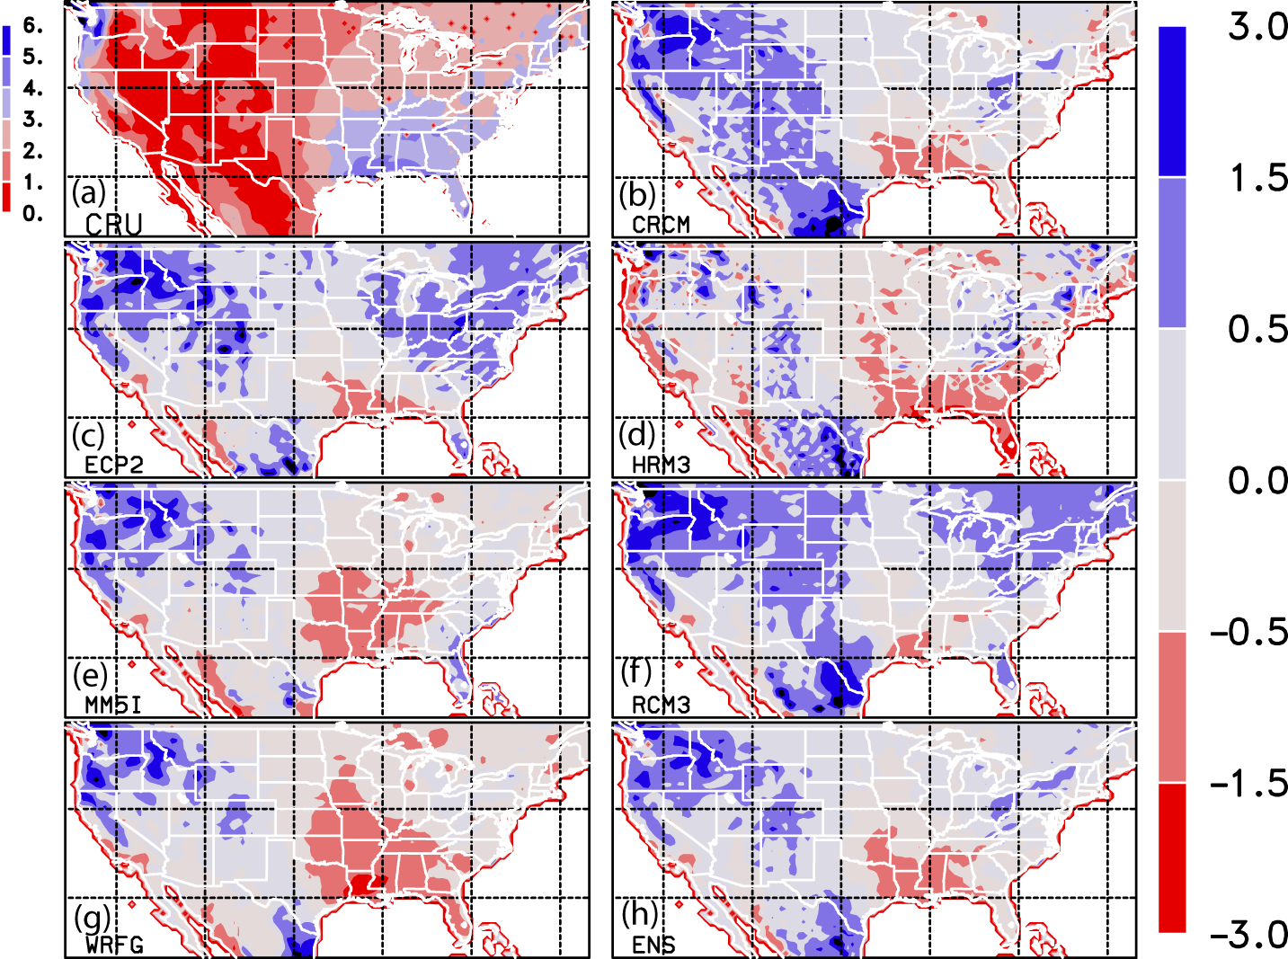
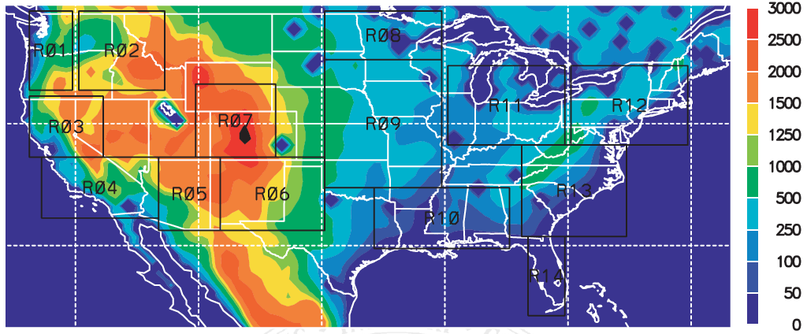
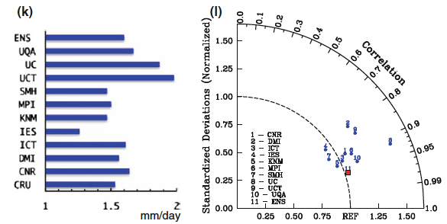
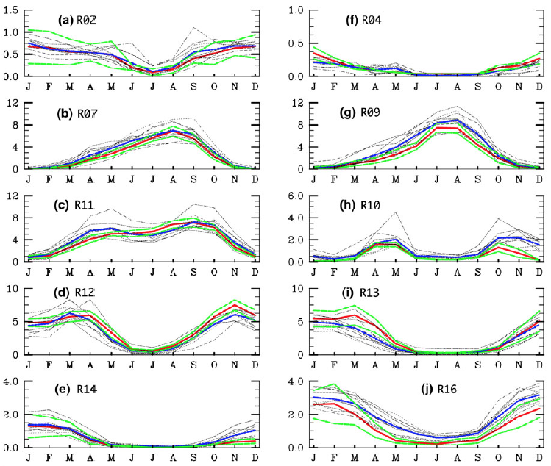
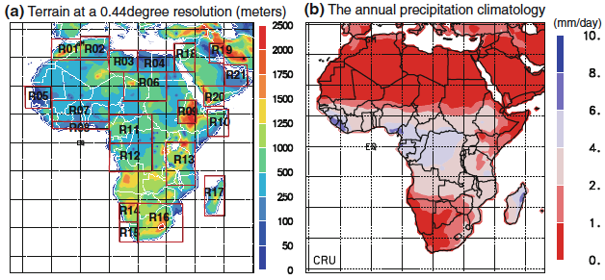
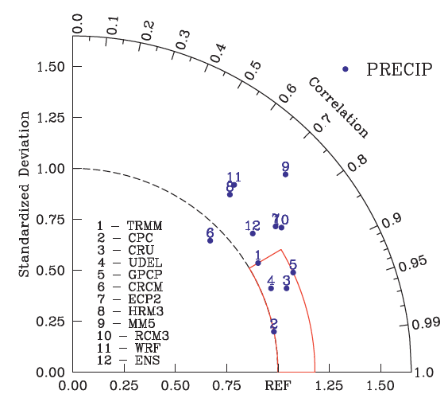
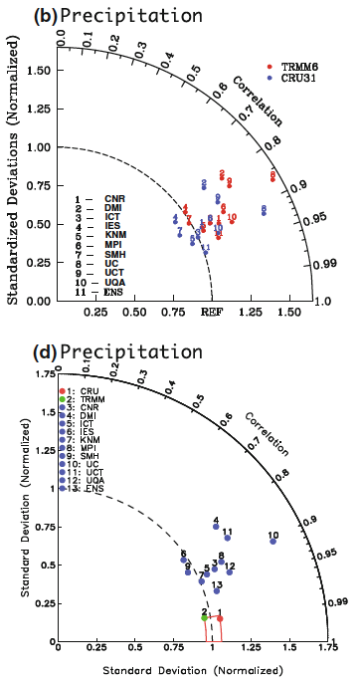
International Conference on Regional Climate – CORDEX 2013, 4-8 November 2013, Brussels, Belgium
Systematic Biases in the CORDEX-Africa and NARCCAP Multi-RCM Hindcast Experiments
Jinwon Kim¹, Duane Waliser^{1,2}, Chris Mattmann^{1,2}, Cameron Goodale², Andrew Hart², Daniel Crichton², Huikyo Lee², Paul Loikith², Maziyar Boustani², Paul Ramirez², Paul Zimdars²
Linda Mearns³, Seth Mcginnis³, Grigory Nikulin⁴, Colin Jones⁴, Alice Favre⁵, Bruce Hewitson⁵, Chris Jack⁵, Christopher Lennard⁵
¹JIFRESSE, UCLA; ²Jet Propulsion Laboratory, NASA; ³NCAR, ⁴SMHI, ⁵UCT
For more info, please contact: jkim@atmos.ucla.edu, duane.waliser@jpl.nasa.gov, chris.a.mattmann@jpl.nasa.gov; Also visit http://rcmes.jpl.nasa.gov
Po-P3-30
Introduction
Climate models play a crucial role in developing plans to mitigate and adapt to climate variations and change for sustainable developments.
Evaluation of climate models is an important step in the judicious application of climate model projections to climate change impacts assessments.
  Uncertainties propagate according to model hierarchy
  Bias correction & multi-model ensemble construction.
  Observations also include uncertainties.
We evaluate precipitation, a key variable for a number of impact assessments, in the CORDEX-Africa & NARCCAP.
Regional Climate Model Evaluation System
(http://rcmes.jpl.nasa.gov)
Regional Climate Model Evaluation System
(http://rcmes.jpl.nasa.gov)
Easy access to reference data facilitates model evaluation.
The Regional Climate Model Evaluation System (RCMES) targets to enable researchers to access a large volume of data in various sites, especially from NASA remote sensing and/or assimilation products.
The system is efficient, user friendly, flexible, and expandable to accommodate additional observational data and to calculate various model evaluation metrics.
Figure. The role of observations in climate research and an outline of RCMES
Regional Climate Model Evaluation System (RCMES)
powered by Apache Open Climate Workbench (http://rcmes.jpl.nasa.gov)
Figure. A typical model hierarchy in climate change impact assessments.
Other Data Centers
(ESGF, DAAC, ExArch Network)
URL
User
input
Model data
TRMM
Metadata
Extract OBS data
Extract model data
MODIS
Data Table
Regridder
(Put the OBS & model data on the same time/space grid)
Use the re-gridded data for user’s own analyses and VIS.
AIRS
Extractor for various data formats
Data Table
Cloud Database
Data extractor
(netCDF)
CERES
Data Table
Data Table
Analyzer
Calculate evaluation metrics; assessment model input data
Soil moisture
Data Table
Assess. modeling
Data Table
Data extractor
(netCDF)
ETC
Common Format,
Native grid,
Efficient architecture
Visualizer
(Plot the metrics)
Figure. Precipitation annual cycle in the 14 sub-regions.
Raw Data:
Various sources, formats,
Resolutions,
Coverage
RCMED
(Regional Climate Model Evaluation Database)
A large scalable database to store data from variety of sources in a common format
RCMET
(Regional Climate Model Evaluation Tool)
A library of codes for extracting data from RCMED and model and for calculating evaluation metrics
Precipitation biases show common regional features:
  Wet biases over the Pacific NW region in all RCMs
  Dry biases over the Gulf coast region in all models.
Model ensemble show the highest skill in simulating the spatial pattern in terms of RMSE.
NARCCAP over the Conterminous United States
Precipitation simulated in the multi-RCM NARCCAP hindcast experiment is evaluated over the conterminous US.
14 subregions according to regional climate characteristics.
Figure. Model biases against the CRU Climatology (mm/day)
The conterminous US region and sub-regions for RCM evaluation.
CRU Climatology
Figure. Evaluation of the simulated interannual variability in terms of the bias, normalized by the interannual variability of the CRU data, & correlation coefficients.
CORDEX-Africa (1989-2008)
Model biases vary widely amongst models.
Regionally systematic bias structures exist:
Most models generate wet biases in the Sahel region.
Generally generate dry bias in the SH east Africa coast.
Large inter-model variations in the tropics.
Most RCMs simulate precipitation within 20% of CRU.
Most models overestimate the magnitude of the spatial variability measured in terms of the standardized deviation.
Model ensemble outperforms individual models in terms of RMSE and pattern correlation, but tends to underestimate the magnitude of the spatial variability.
Terrain and CRU Climatology (mm/day)
Biases (mm/day)
The RCM skill in simulating the precipitation annual cycle varies regionally with higher/lower skill in the western/eastern Africa coast in general.
All RCMs perform well for the Mediterranean region.
Uncertainties in Precipitation Observations
Accurate observations are crucial for reliable model evaluations and data analyses. All observations include uncertainties from various sources, but quantitative information on the range of uncertainties is usually unknown for most observation datasets. Intercomparison of multiple observation may help to estimate observational uncertainties.
Figure. Observational uncertainties in evaluating the spatial variability in the annual mean precipitation over the CORDEX Africa region: (Top) The simulated precipitation is evaluated against the TRMM (red) and CRU (blue) data. Results show that both observations yield similar evaluation results except slight difference in the magnitude of the spatial variability. (Bottom) Both the model and two different observations are ‘evaluated’ against the simple ensemble of two observations. The area defined by the red lines may be taken as the range of observational uncertainties.
Spatial variability of the annual-mean precipitation climatology varies widely among the multiple datasets examined in this study.
For both regions, model performance is out of the range of uncertainty defined by multiple observations.
The separation between the model errors and the observational uncertainties is larger in the NARCCAP experiment than in the CORDEX-Africa experiment.
It is important to cross-examine all available observations before applying these data to model evaluations and climate analyses to understand the uncertainty related with observational data.
Figure. Observational uncertainties in evaluating the spatial variability of the annual-mean precipitation over the conterminous US region. Both the model and five different observations are ‘evaluated’ against the simple ensemble mean of the five observations. The area defined by the red lines may be taken as the range of observational uncertainties.
Conclusions and Discussions
Precipitation simulated in the two regional hindcast experiments, the NARCCAP and CORDEX-Africa, has been evaluated using RCMES.
Model biases show well-defined regional and seasonal structures despite large differences between models for both regions. This must be considered in applying model data to assessment studies.
Observations also show noticeable differences amongst multiple datasets – observational uncertainties must be examined before model evaluation or analysis studies.
Related publications
  Crichton, D.J., C.A. Mattmann, L. Cinquini, A. Braverman, D.E. Waliser, M. Gunson, A. Hart, C. Goodale, P.W. Lean, and J. Kim, 2012: Software and Architecture for Sharing Satellite Observations with the Climate Modeling Community. IEEE Software, 29, 63-71.
  Kim, J., D. Waliser, C. Mattmann, C. Goodale, A. Hart, P. Zimdars, D. Crichton, C. Jones, G. Nikulin, B. Hewitson, C. Jack, C. Lennard, and A. Favre, 2013: Evaluation of the CORDEX-Africa multi-RCM hindcast: systematic model errors. Clim Dyn, DOI 10.1007/s00382-013-1751-7.
  Kim, J., D. Waliser, C. Mattmann, L. Mearns, C. Goodale, A. Hart, D. Crichton, S. McGinnis, H. Lee, P. Lokith, and M. Boustani, 2013: Evaluations of the surface climatology over the conterminous United States in the North American Regional Climate Change Assessment Program hindcast experiment using a regional climate model evaluation system. J. Climate, 26, 5698-5715.
Mattmann, C., D. Waliser, J. Kim, C. Goodale, A. Hart, P. Ramirez, D. Crichton, P. Zimdars, M. Boustani, H. Lee, P. Loikith, K. Whitehall, C. Jack, and B. Hewitson, 2013: Cloud computing and virtualization within the Regional Climate Model Evaluation System. Earth Sci Informatics, doi 10.1007/s12145-013-0126-2.
  Whitehall, K., C. Mattmann, D. Waliser, J. Kim, C. Goodale, A. Hart, P. Ramirez, P. Zimdars, D. Crichton, G. Jenkins, C. Jones, G. Asrar, and B. Hewitson, 2012: Building model evaluation and decision support capacity for CORDEX. WMO Bulletin, 61, 29-34.
Acknowledgements
This study was supported by NASA NCA (ID 11-NCA11-0028), NASA AIST (ID 87-17895-11), NSF ExArch (ID 1125798), and NSF EaSM (ID 2011-67004-30224) project. The contribution from D. Waliser, C. Mattmann, C. Goodale, A. Hart, P. Zimdars, D. Crichton, H. Lee, P. Loikith, M. Boustani, P. Ramirez, and P. Zimdars to this study was performed on behalf of the Jet Propulsion Laboratory, California Institute of Technology, under a contract with the National Aeronautics and Space Administration.

